Slide 1
Global Day of Prayer to End Famine – 21 May 2017
Photos from South Sudan, 2017 by Paul Jeffrey/ACT Alliance

Slide 2
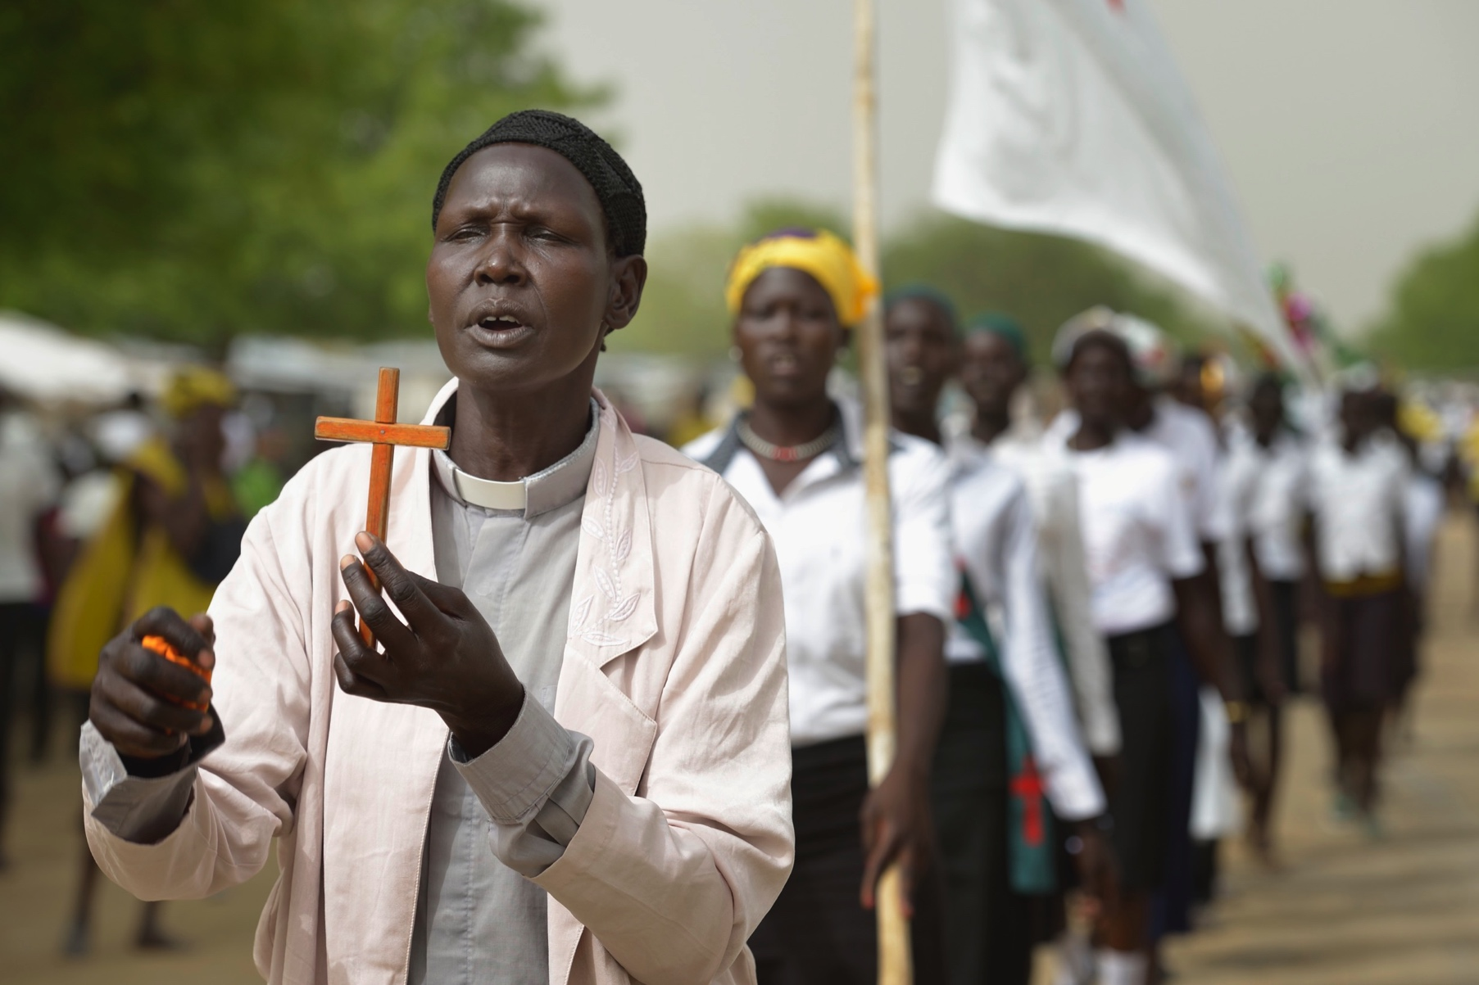
© Paul Jeffrey/ACT Alliance

Slide 3
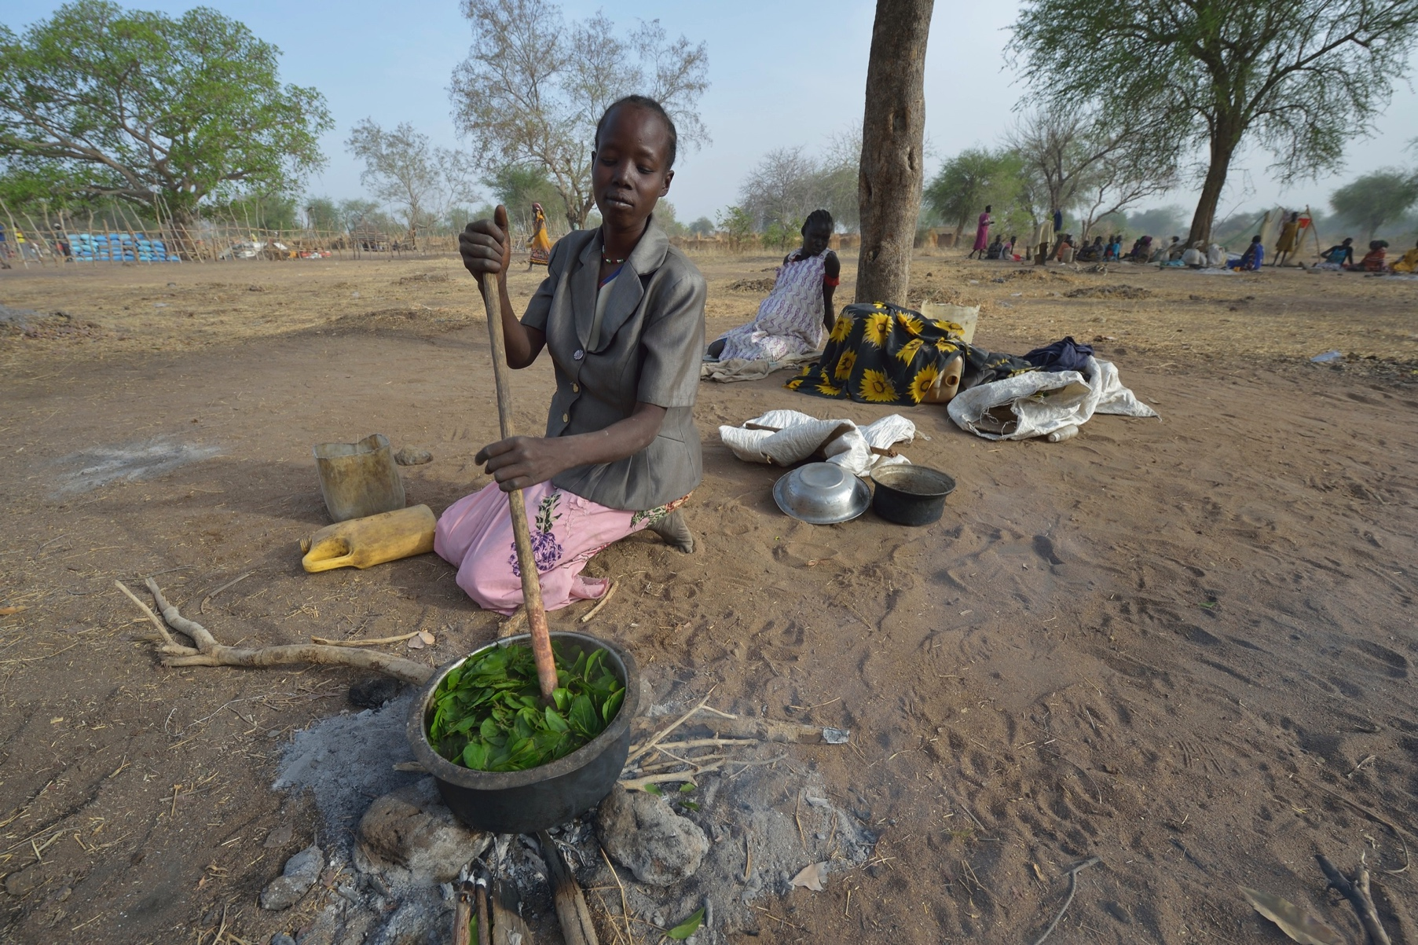
© Paul Jeffrey/ACT Alliance

Slide 4
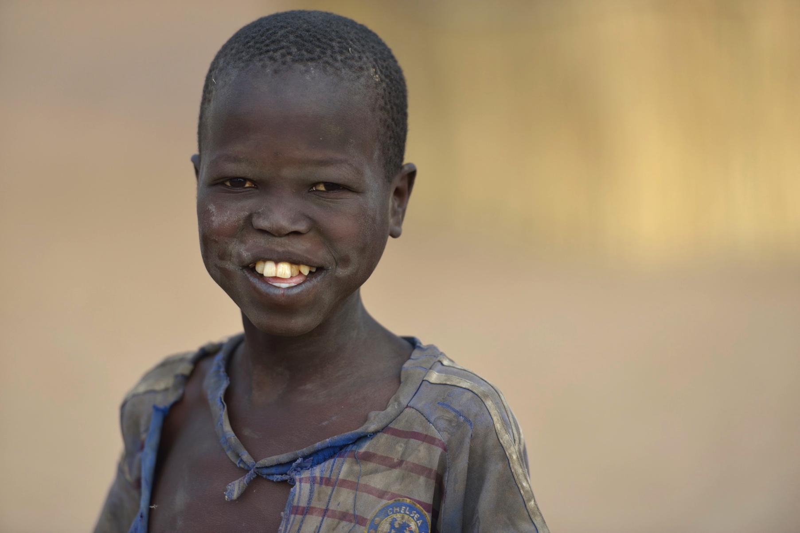
© Paul Jeffrey/ACT Alliance

Slide 5
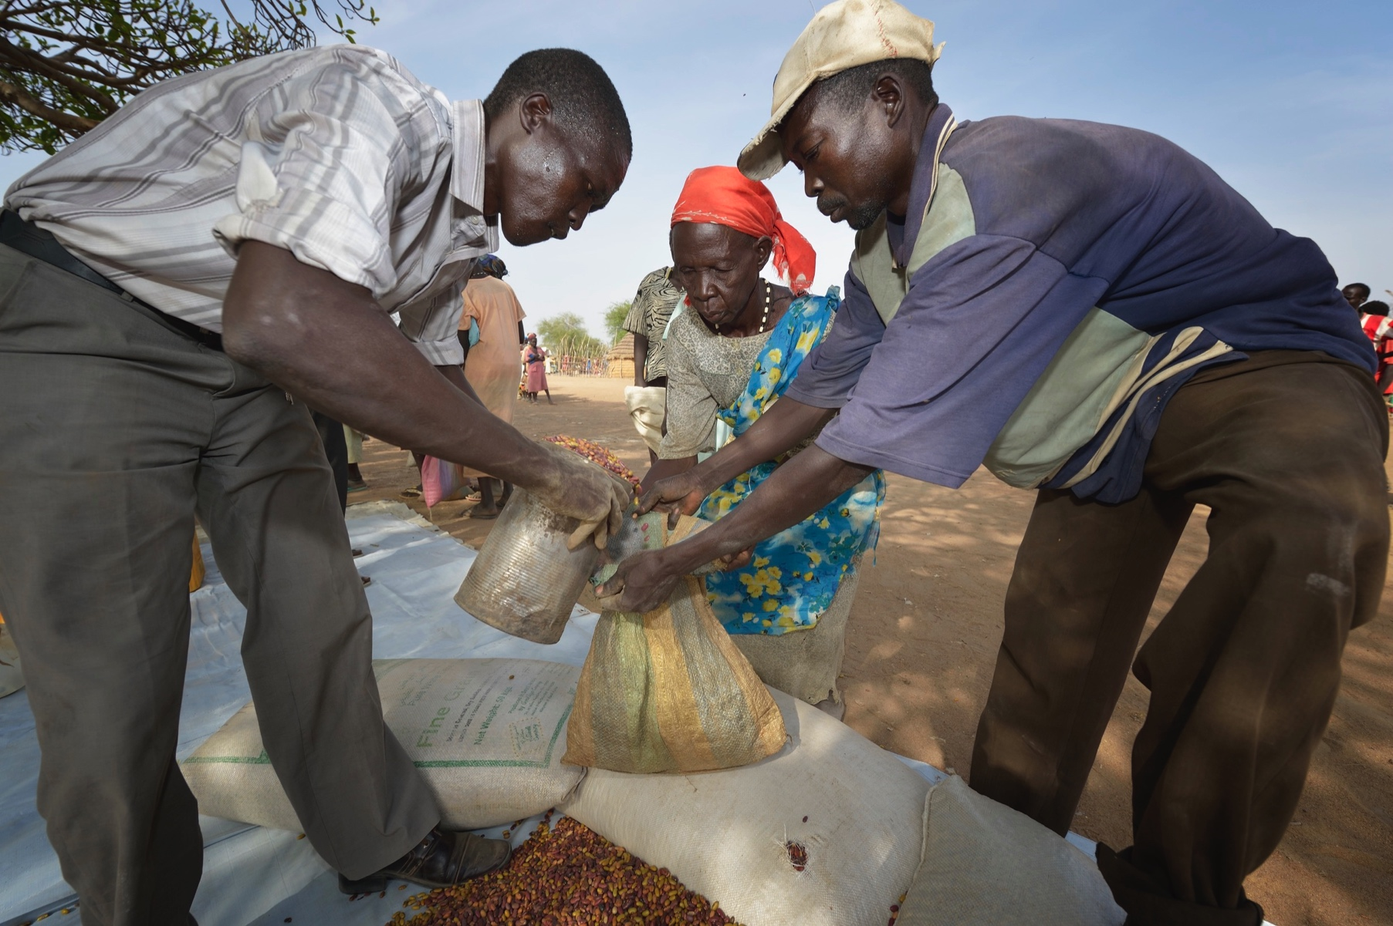
© Paul Jeffrey/ACT Alliance

Slide 6
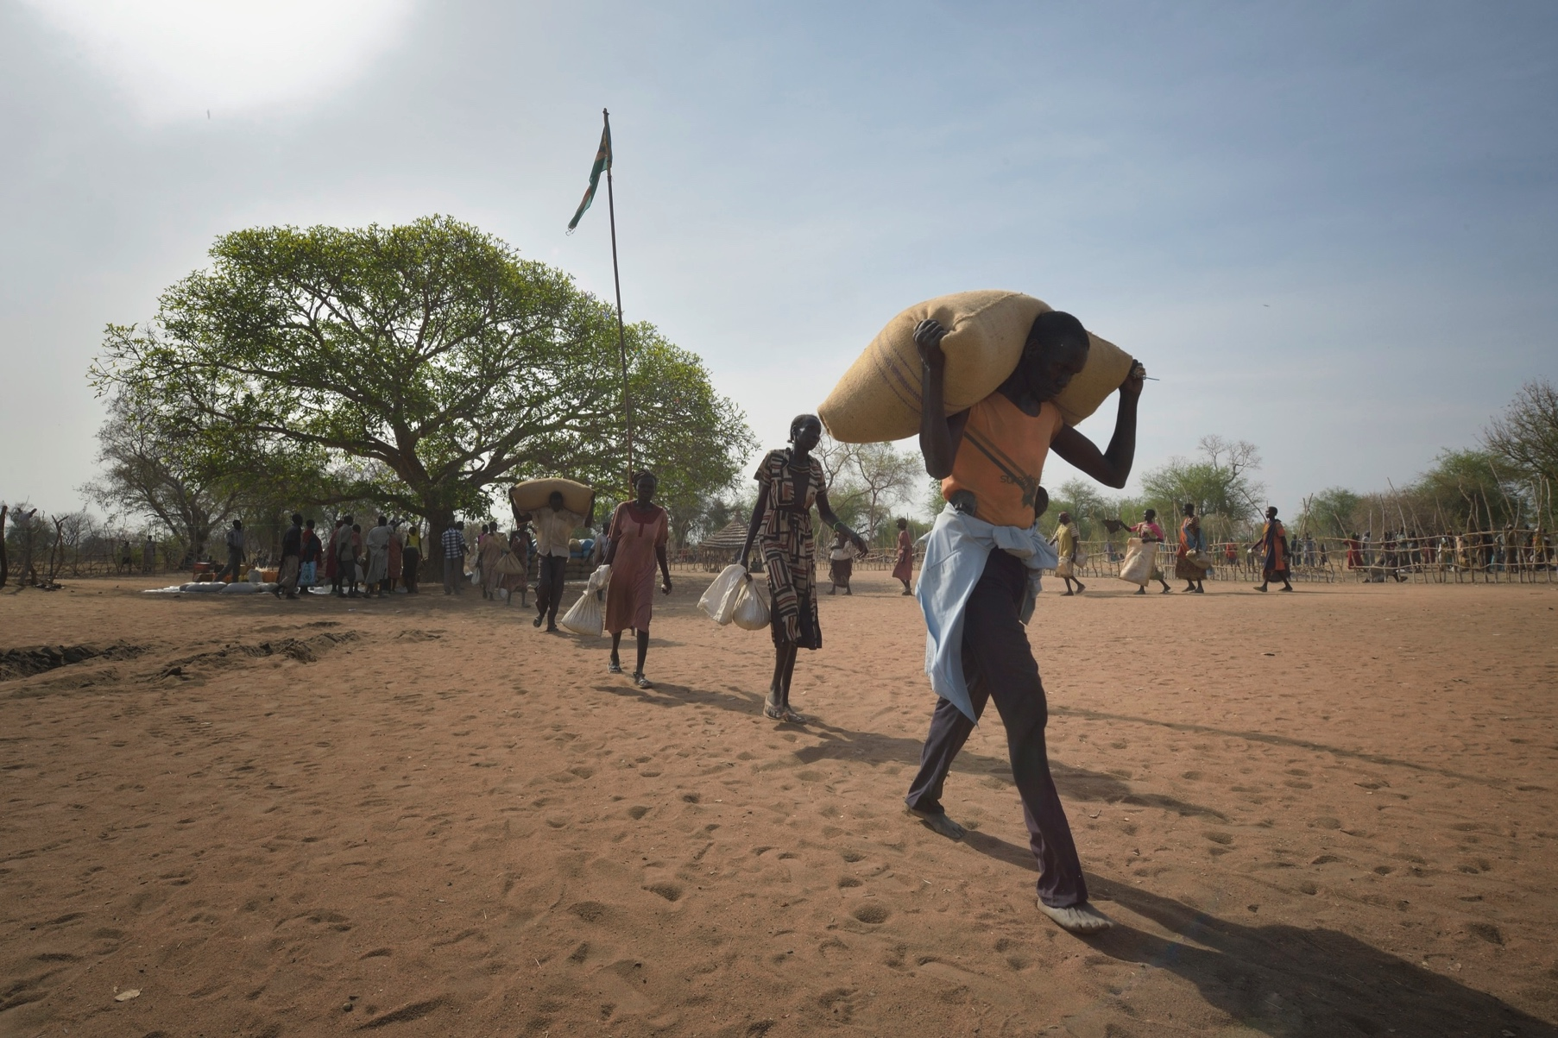
© Paul Jeffrey/ACT Alliance

Slide 7
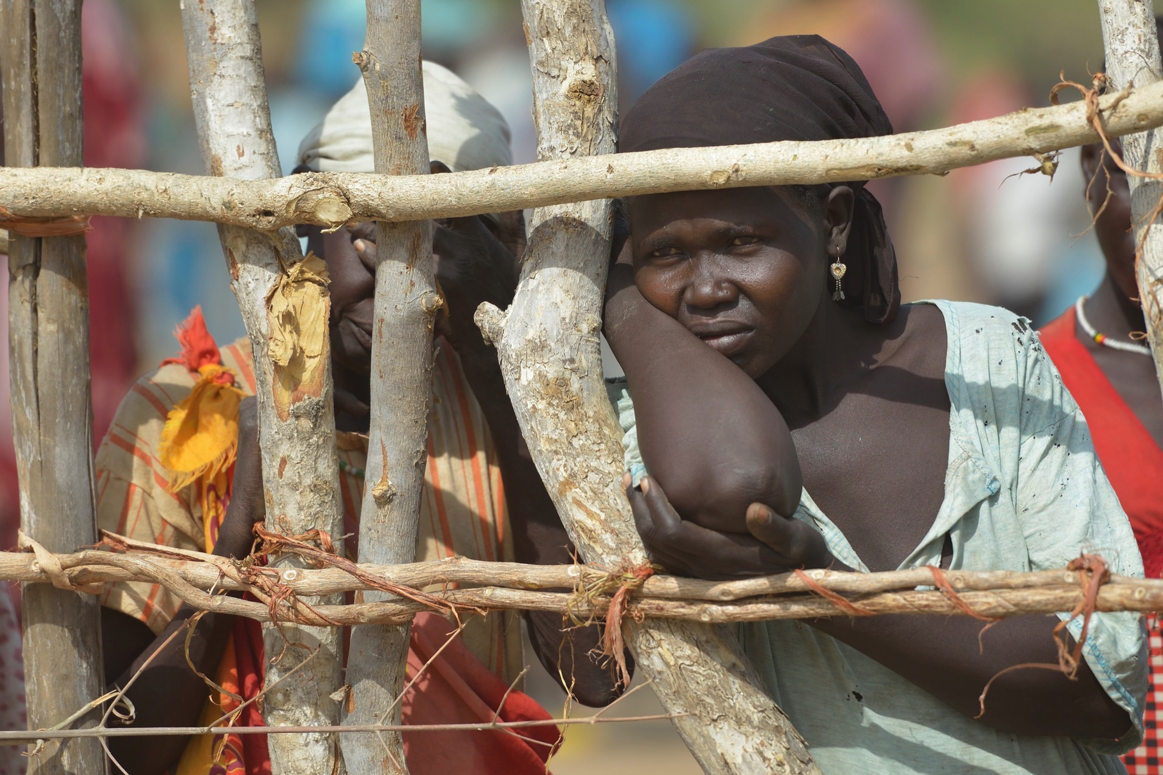
© Paul Jeffrey/ACT Alliance

Slide 8
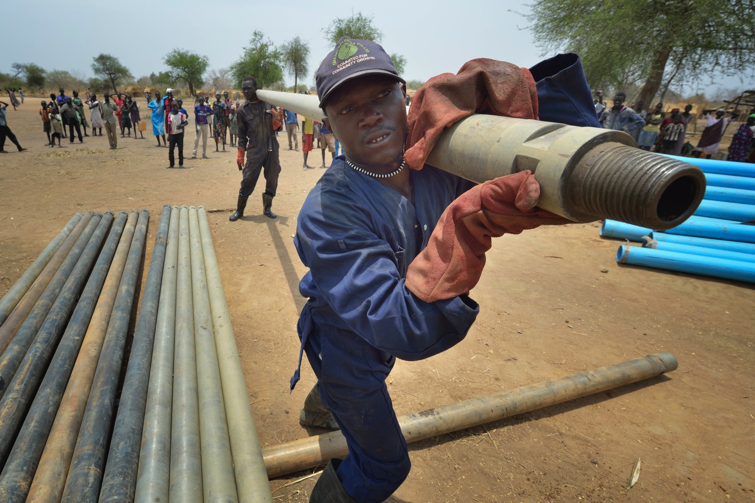
© Paul Jeffrey/ACT Alliance

Slide 9
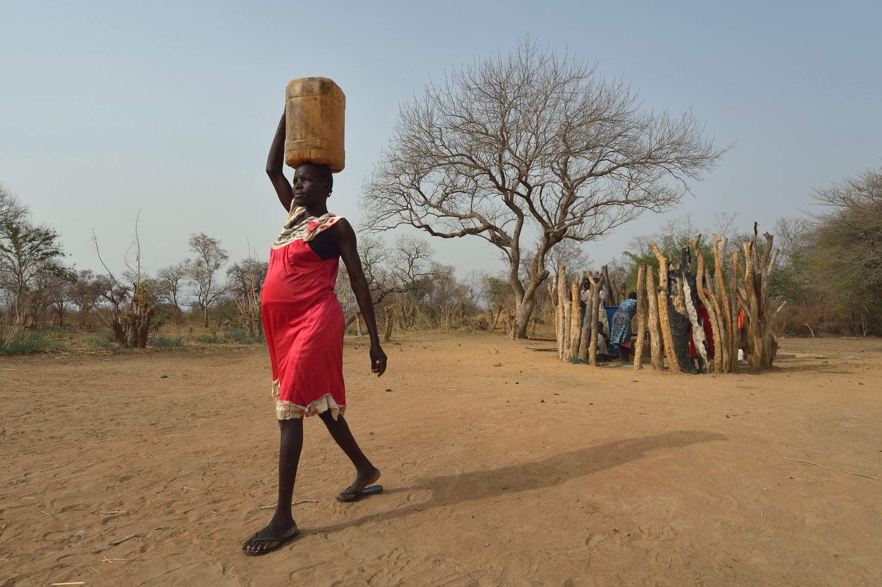
© Paul Jeffrey/ACT Alliance

Slide 10
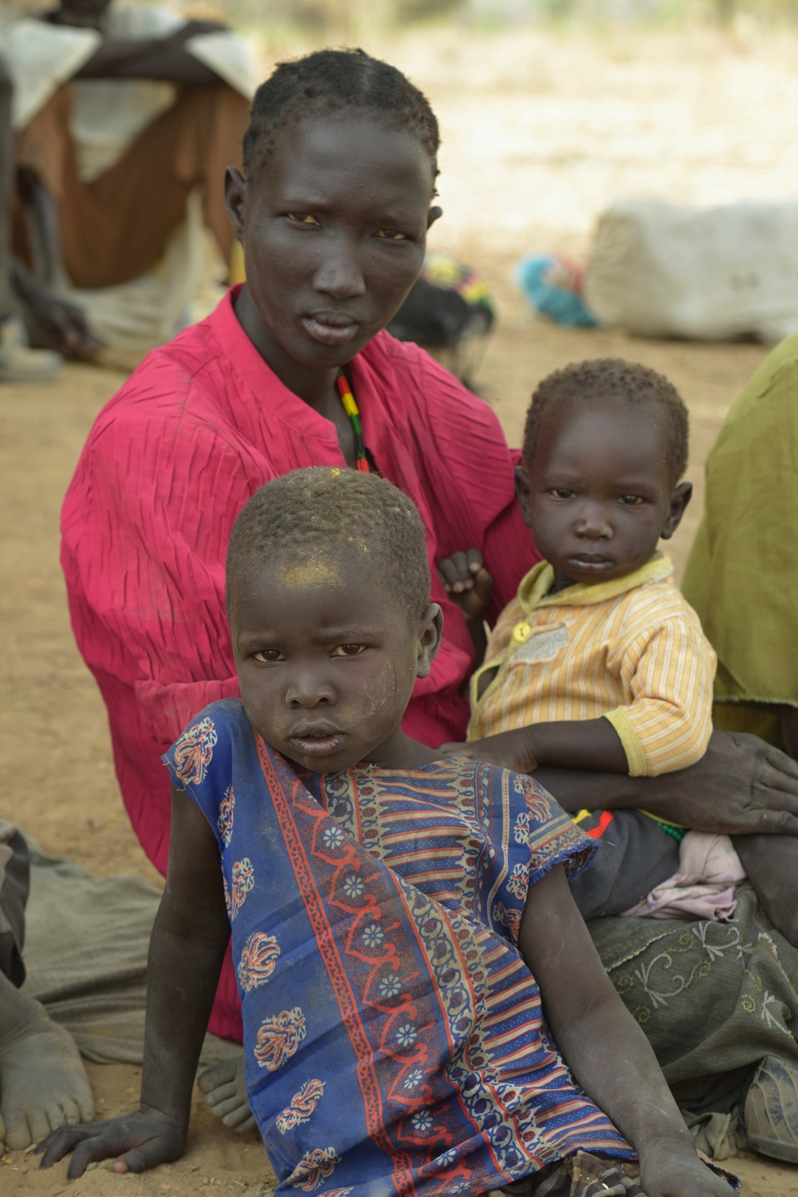
© Paul Jeffrey/ACT Alliance
© Paul Jeffrey/ACT Alliance

Slide 11
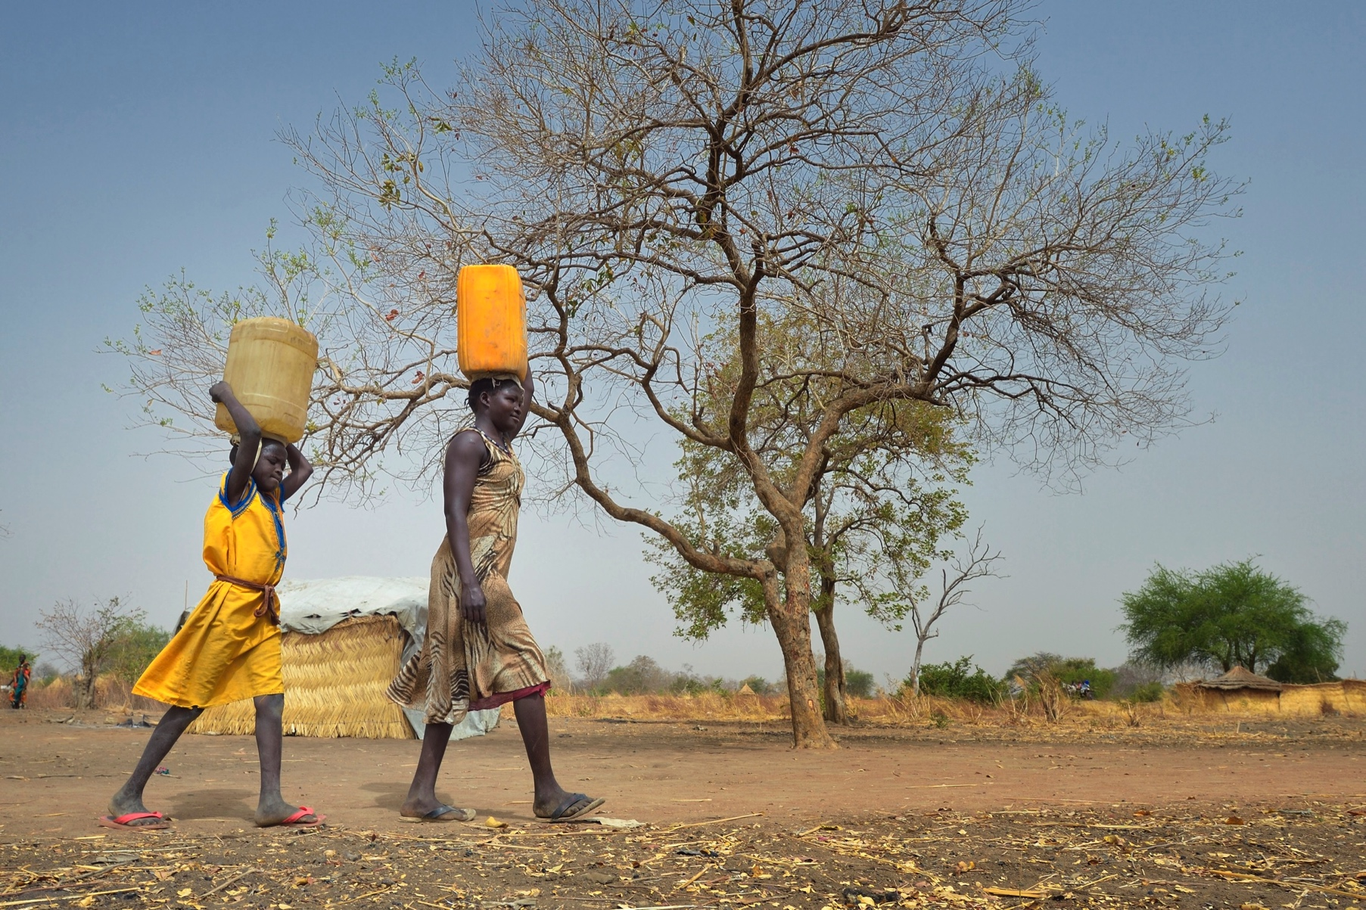
© Paul Jeffrey/ACT Alliance

Slide 12
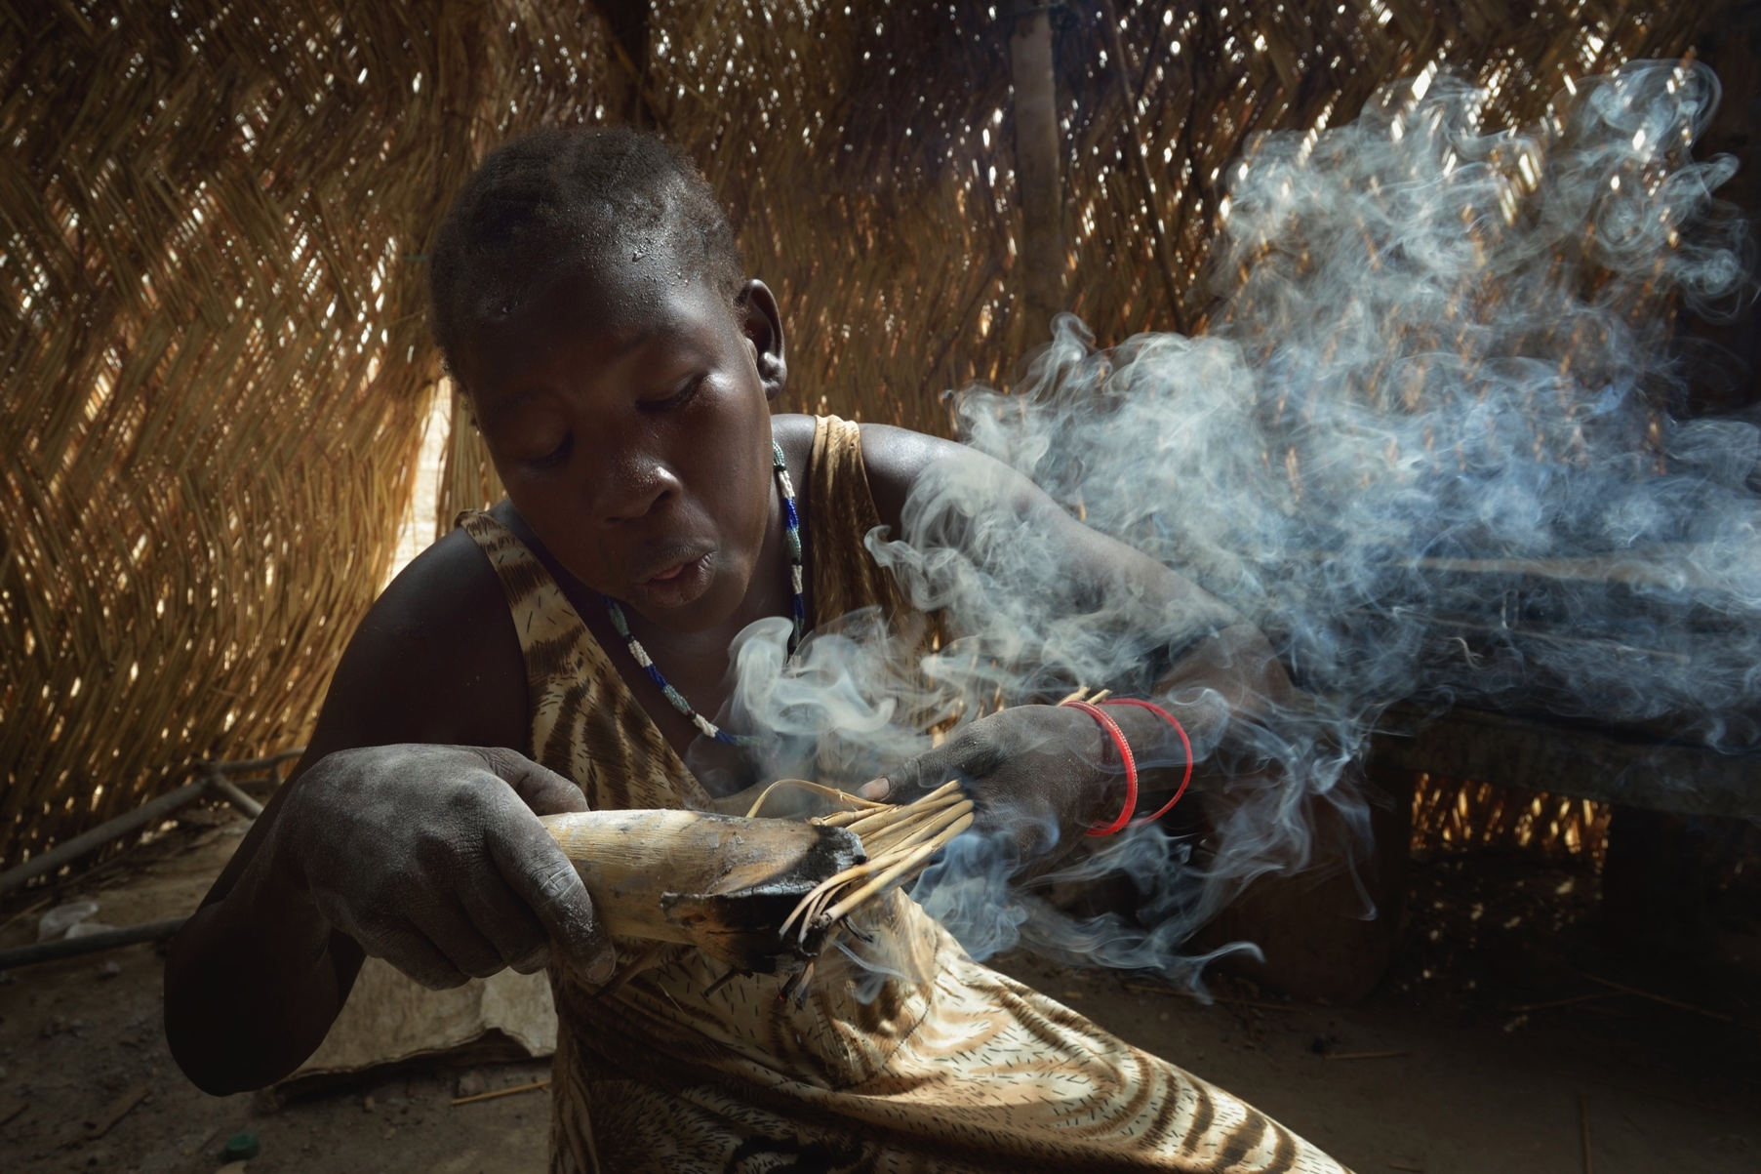
© Paul Jeffrey/ACT Alliance

Slide 13
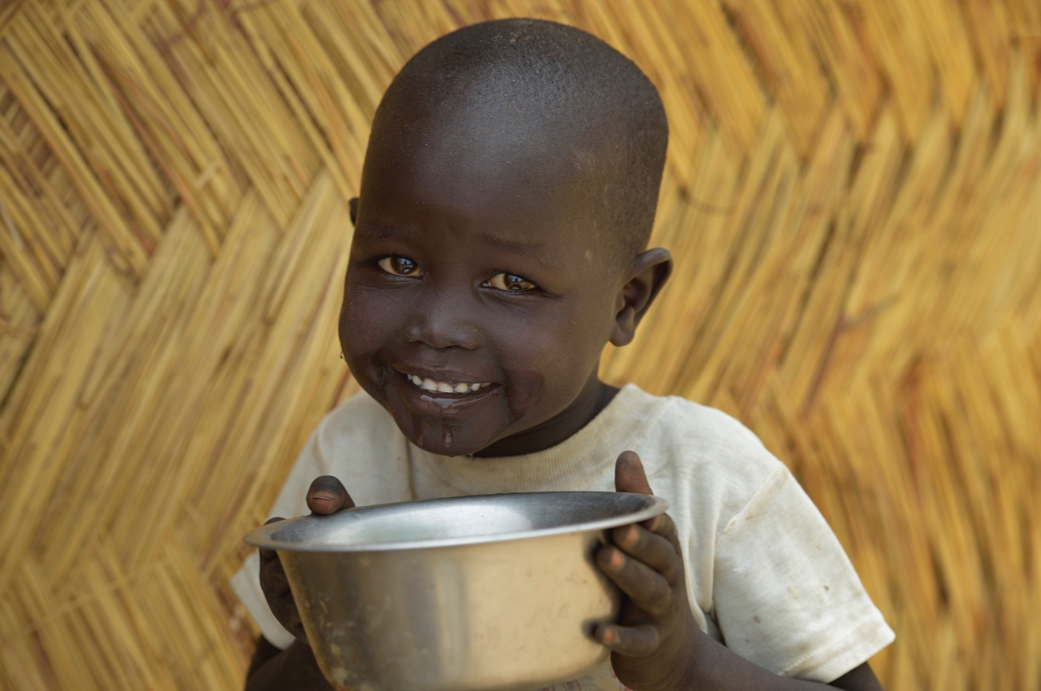
© Paul Jeffrey/ACT Alliance

Slide 14
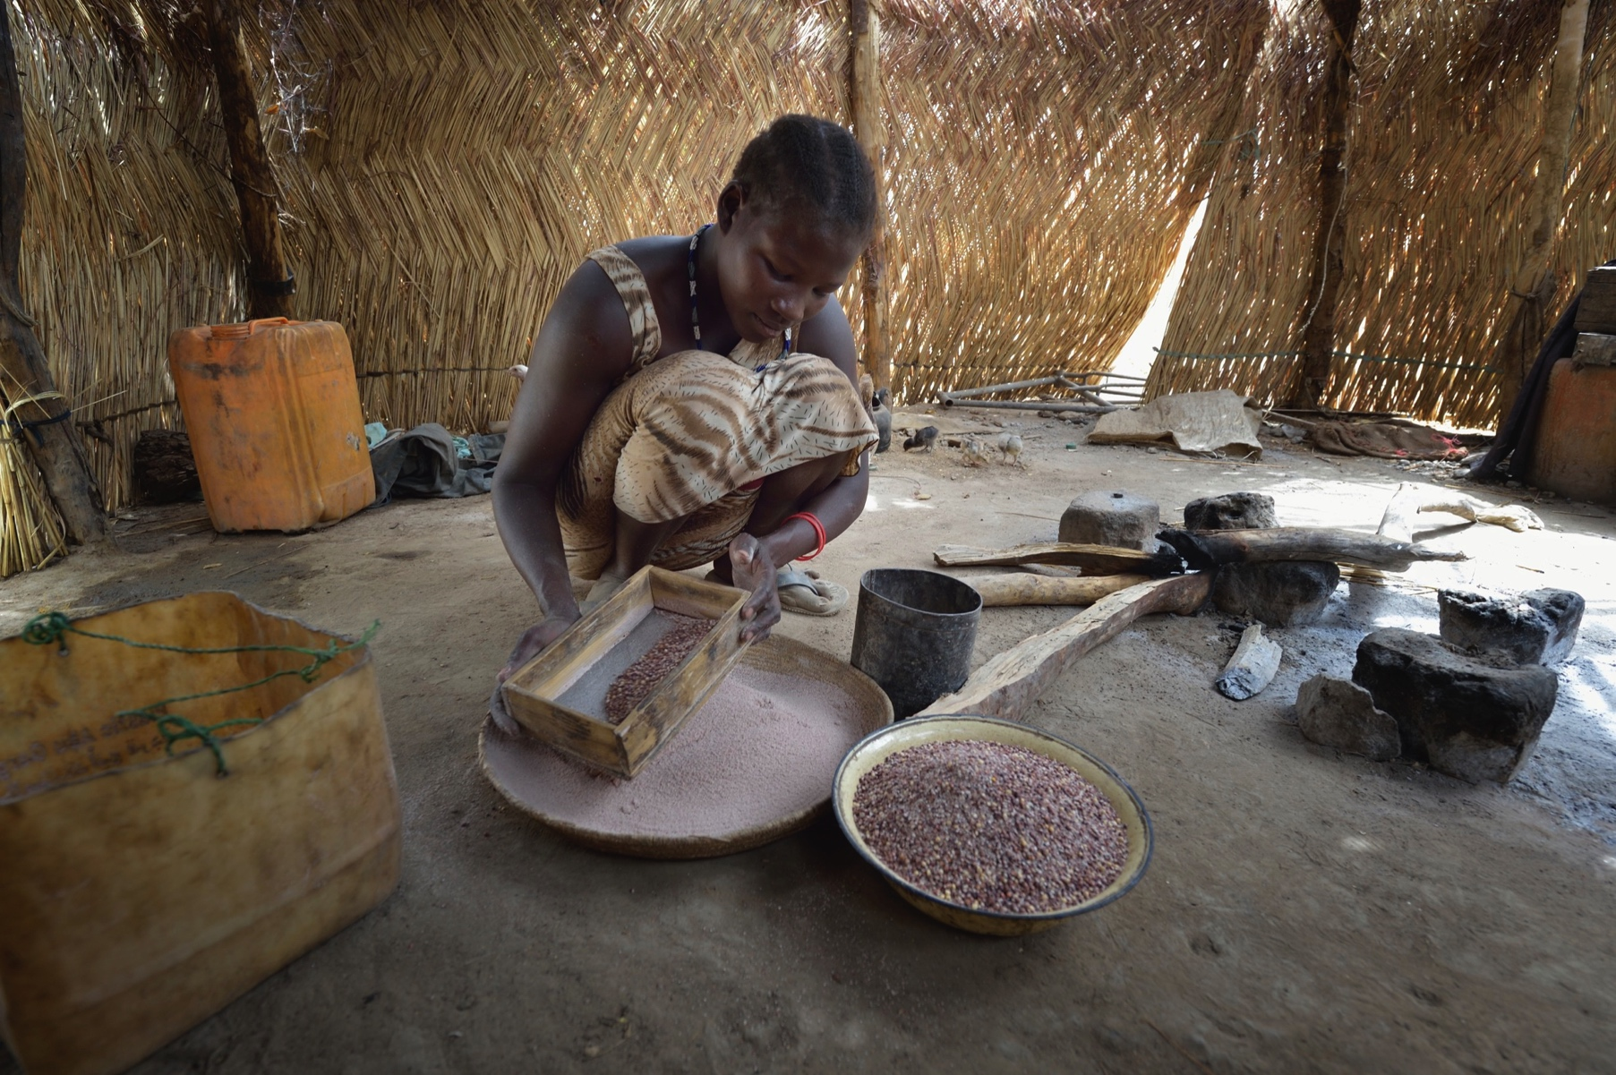
© Paul Jeffrey/ACT Alliance

Slide 15
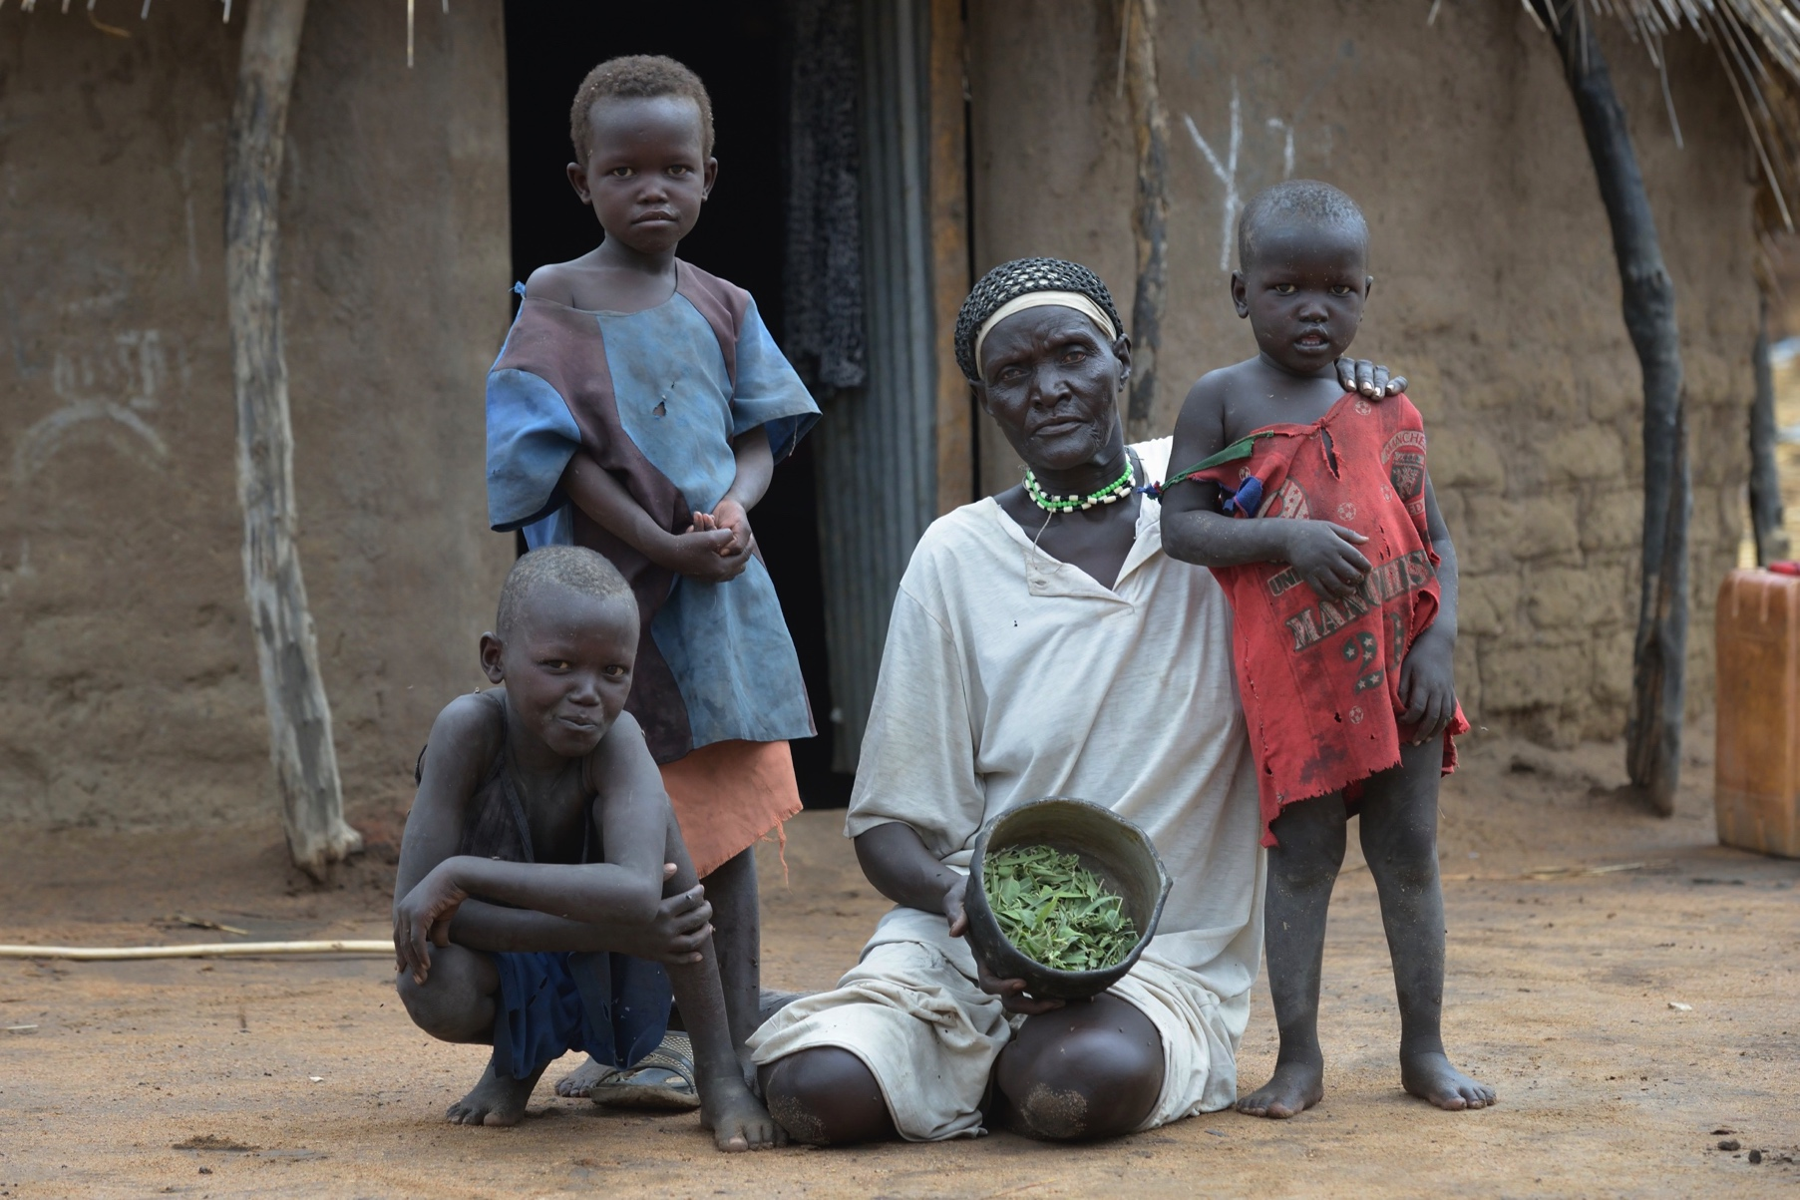
© Paul Jeffrey/ACT Alliance

Slide 16
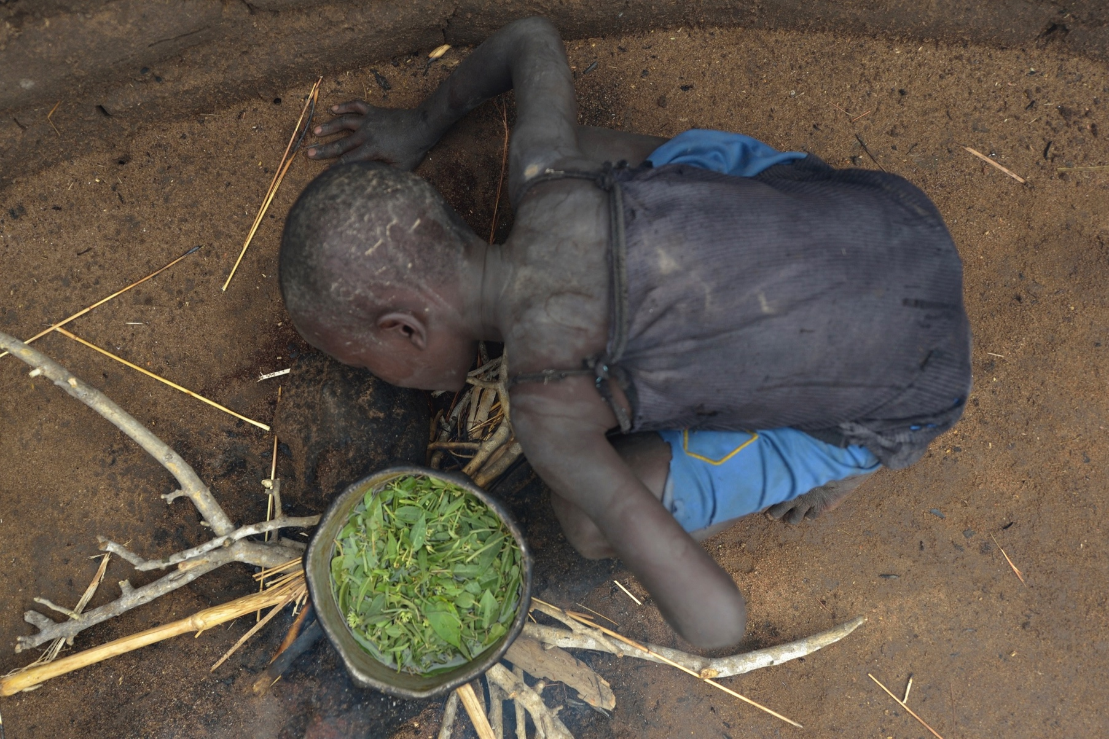
© Paul Jeffrey/ACT Alliance

Slide 17
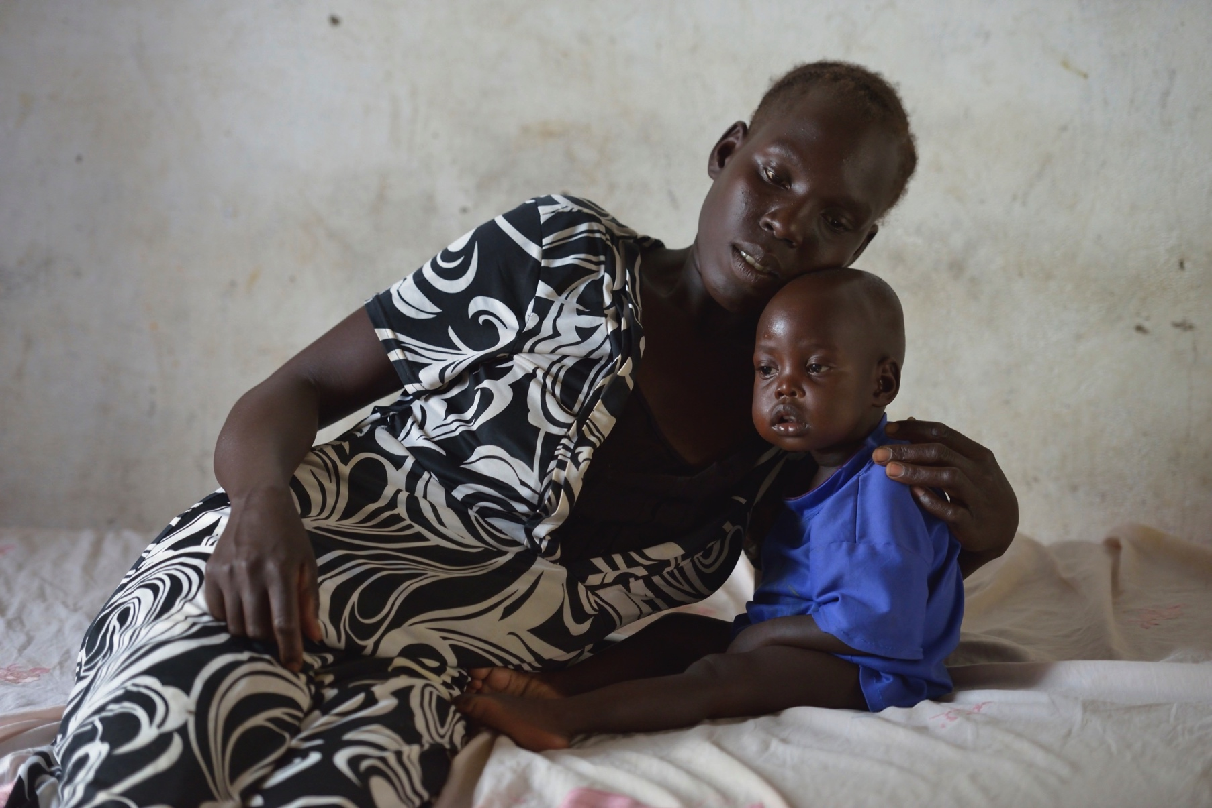
© Paul Jeffrey/ACT Alliance

Slide 18
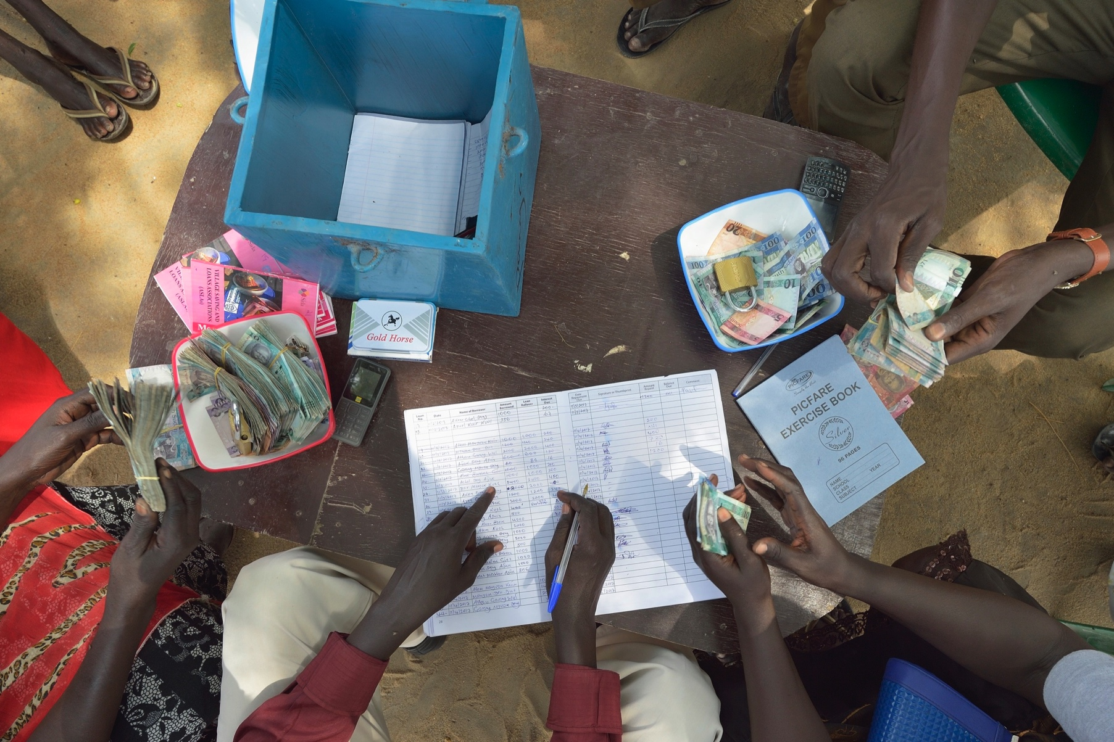
© Paul Jeffrey/ACT Alliance

Slide 19
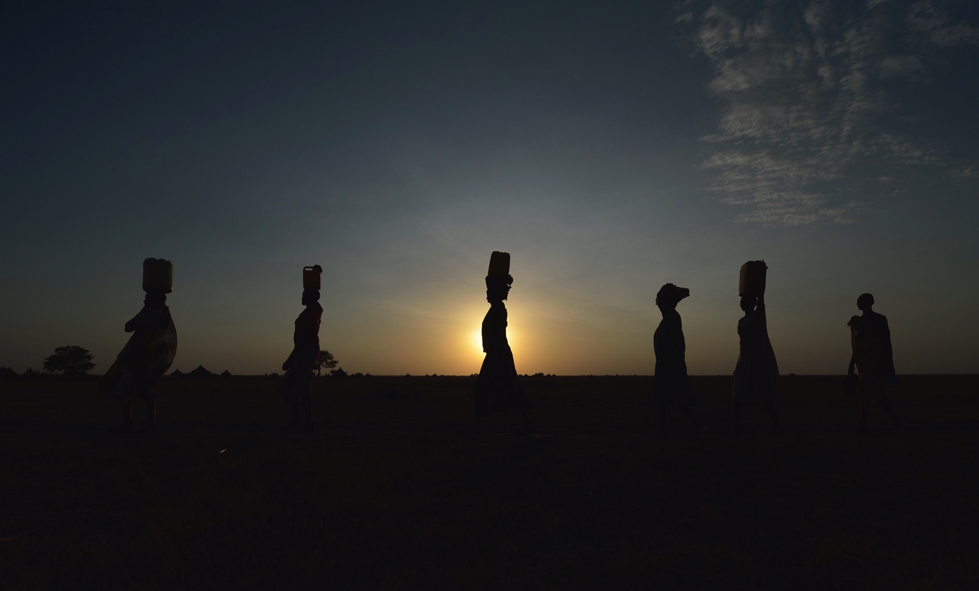
© Paul Jeffrey/ACT Alliance

Slide 20
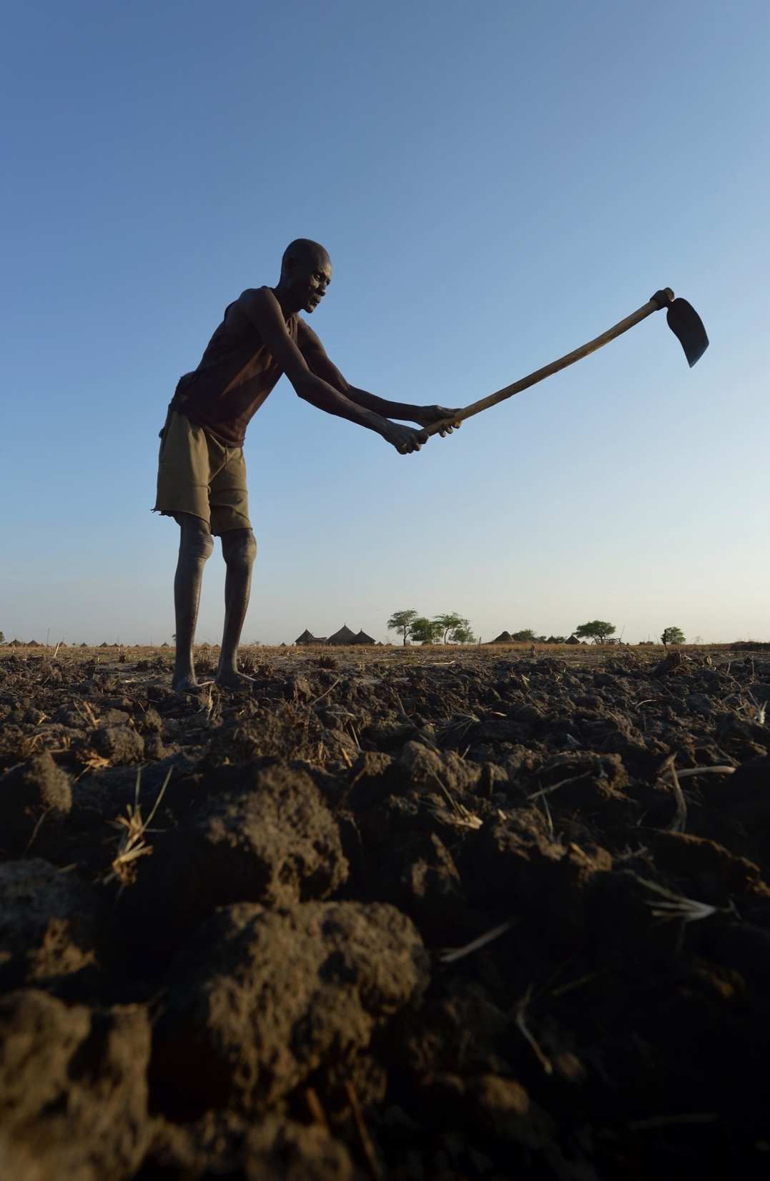
© Paul Jeffrey/ACT Alliance

Slide 21
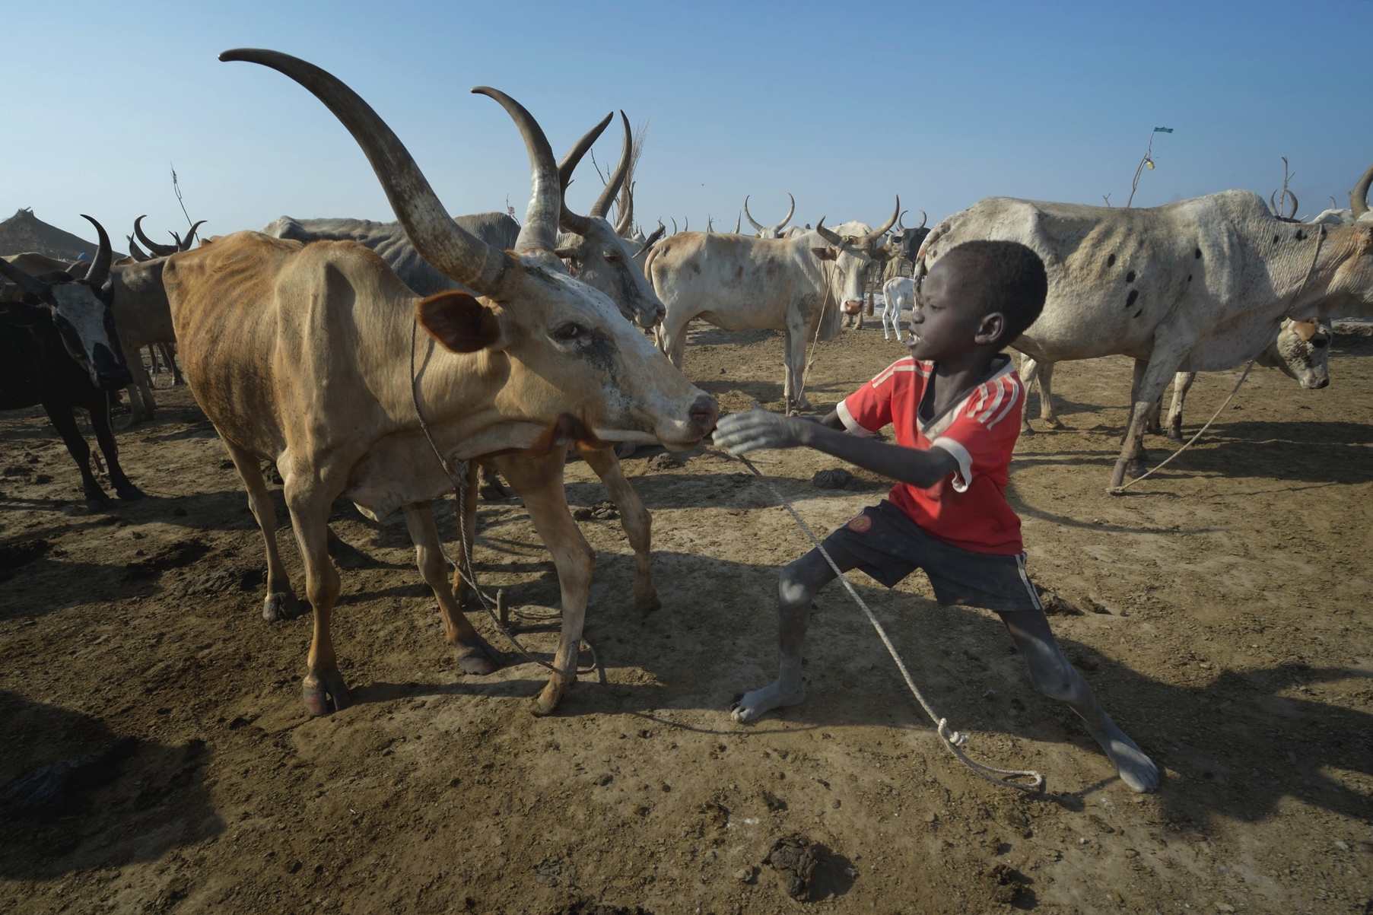
© Paul Jeffrey/ACT Alliance

Slide 22
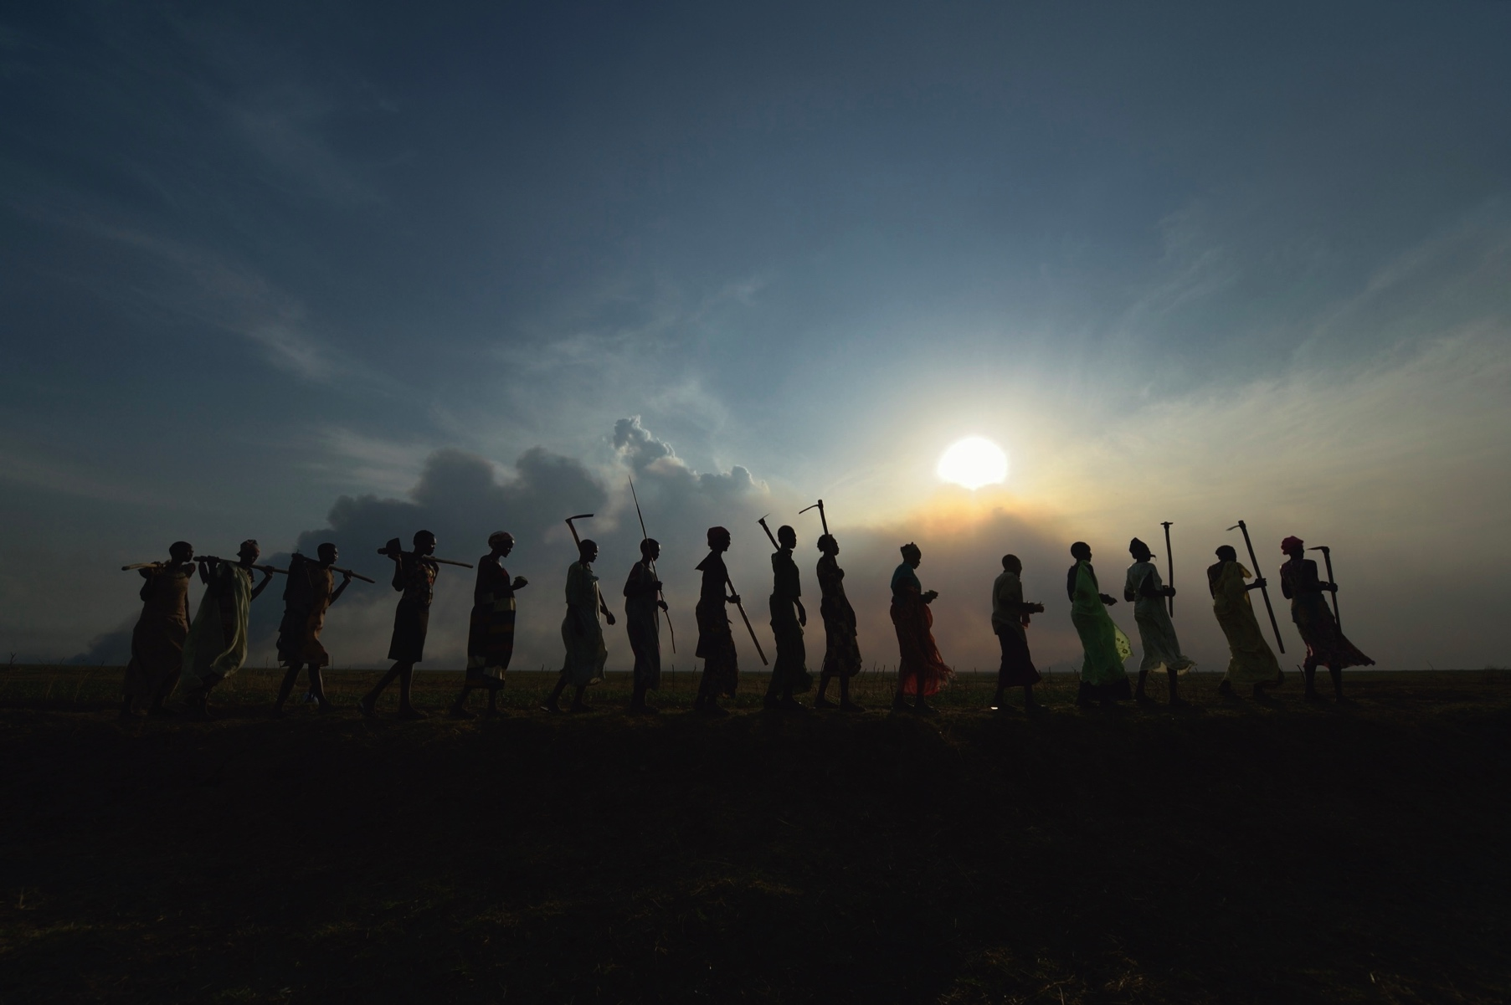
© Paul Jeffrey/ACT Alliance

Slide 23
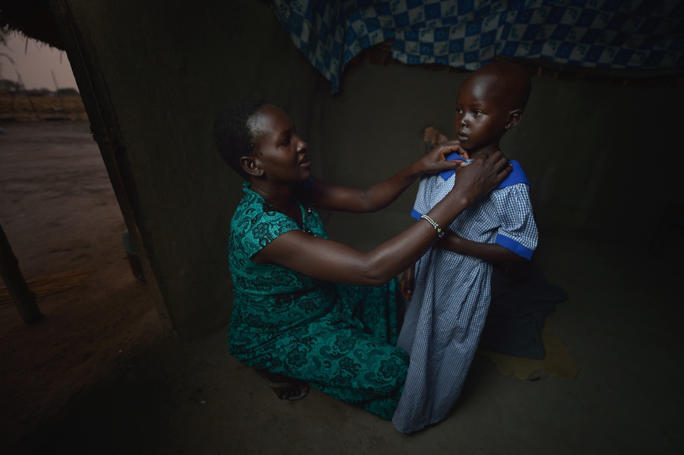
© Paul Jeffrey/ACT Alliance

Slide 24
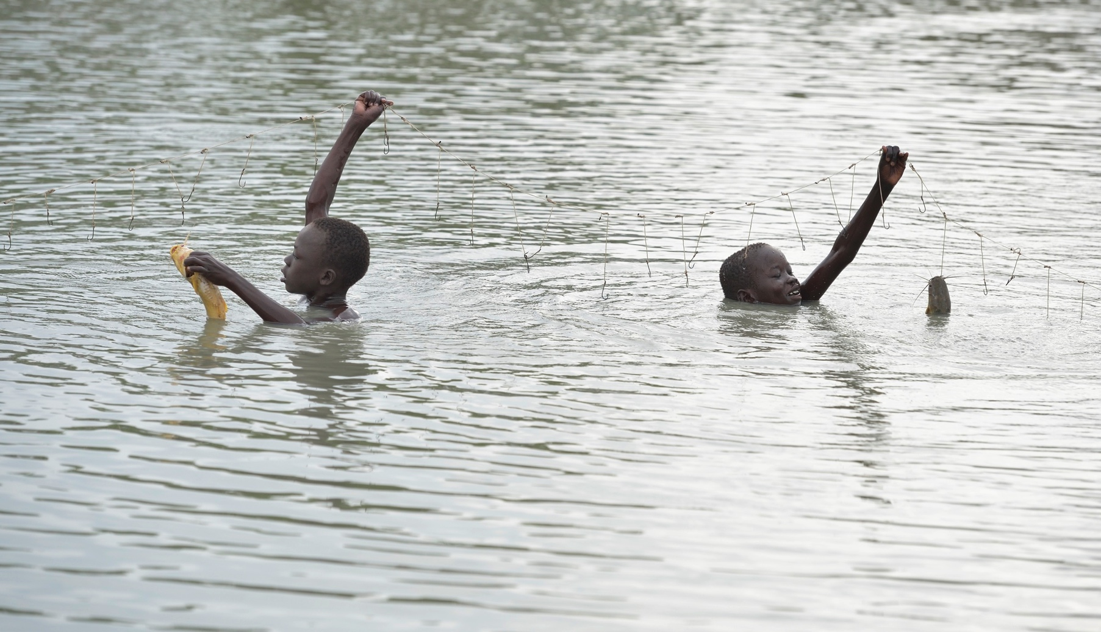
© Paul Jeffrey/ACT Alliance

Slide 25
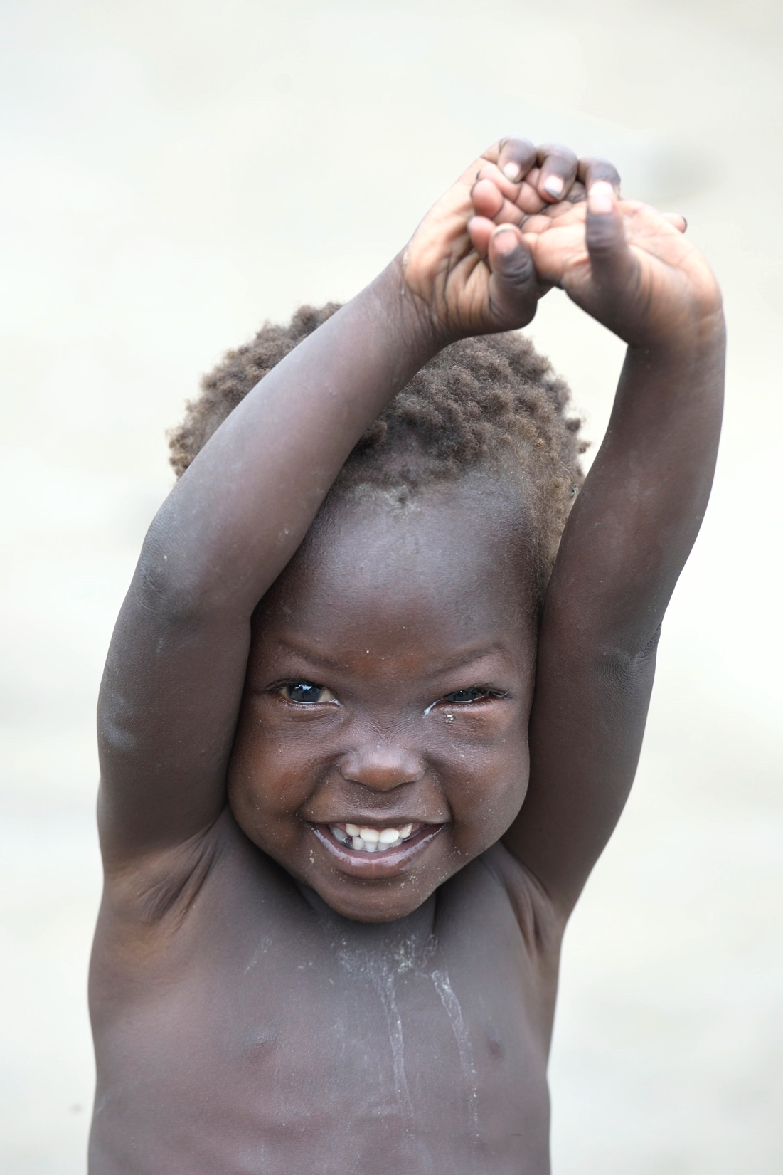
© Paul Jeffrey/ACT Alliance

Slide 26
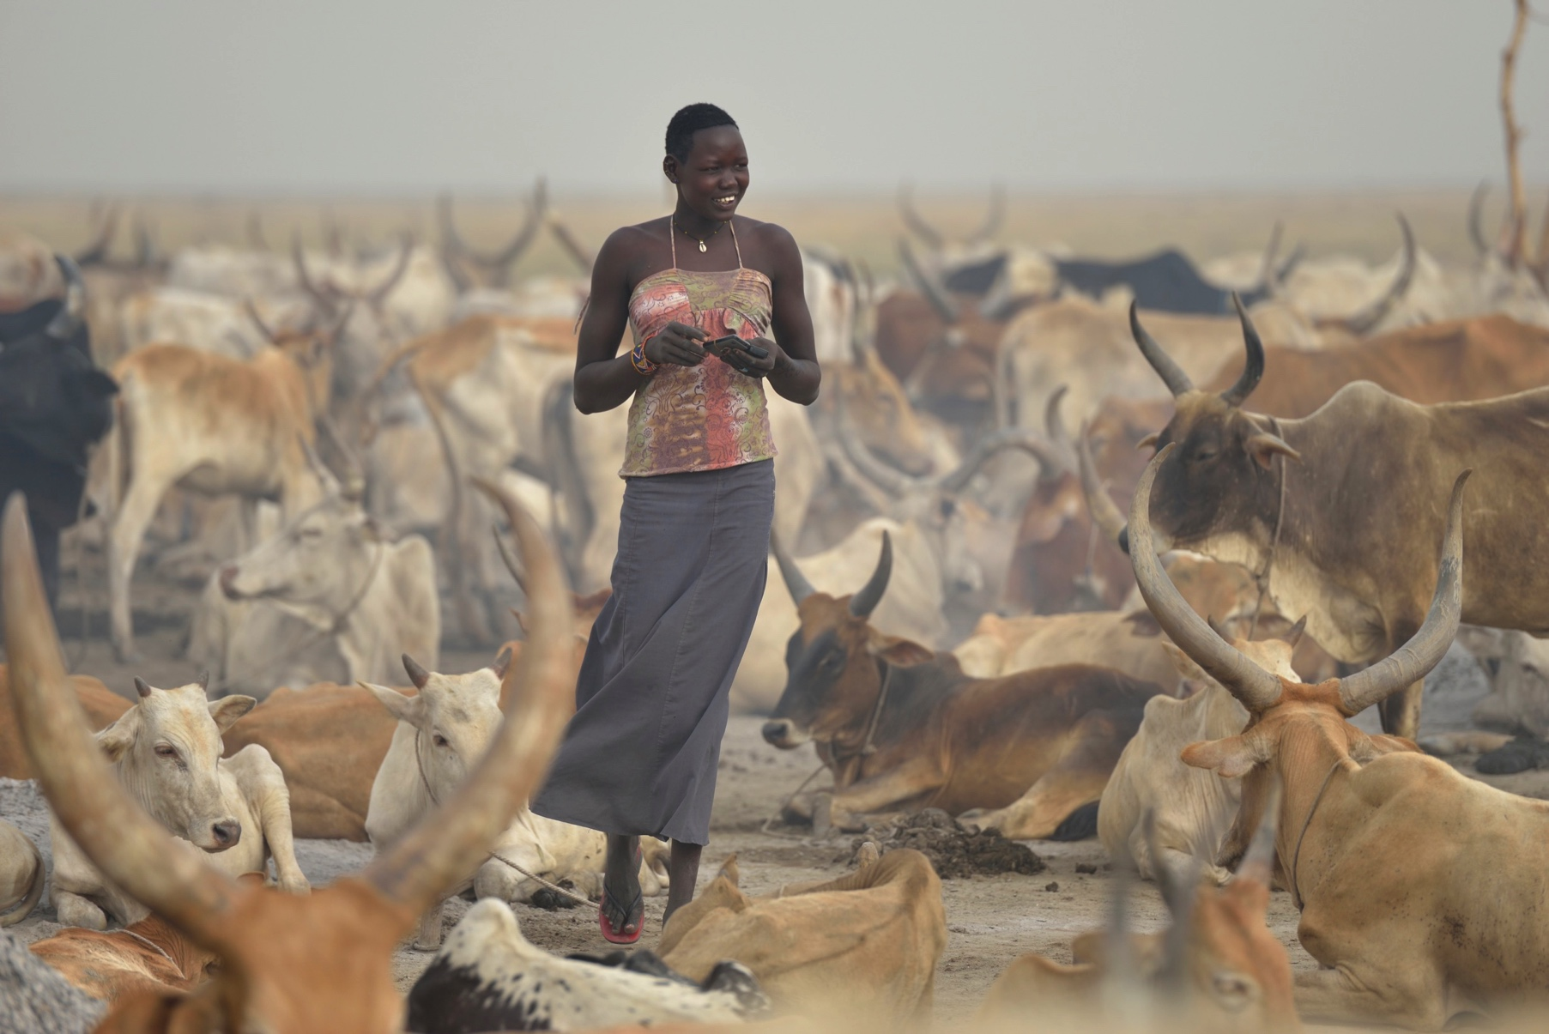
© Paul Jeffrey/ACT Alliance

Slide 27
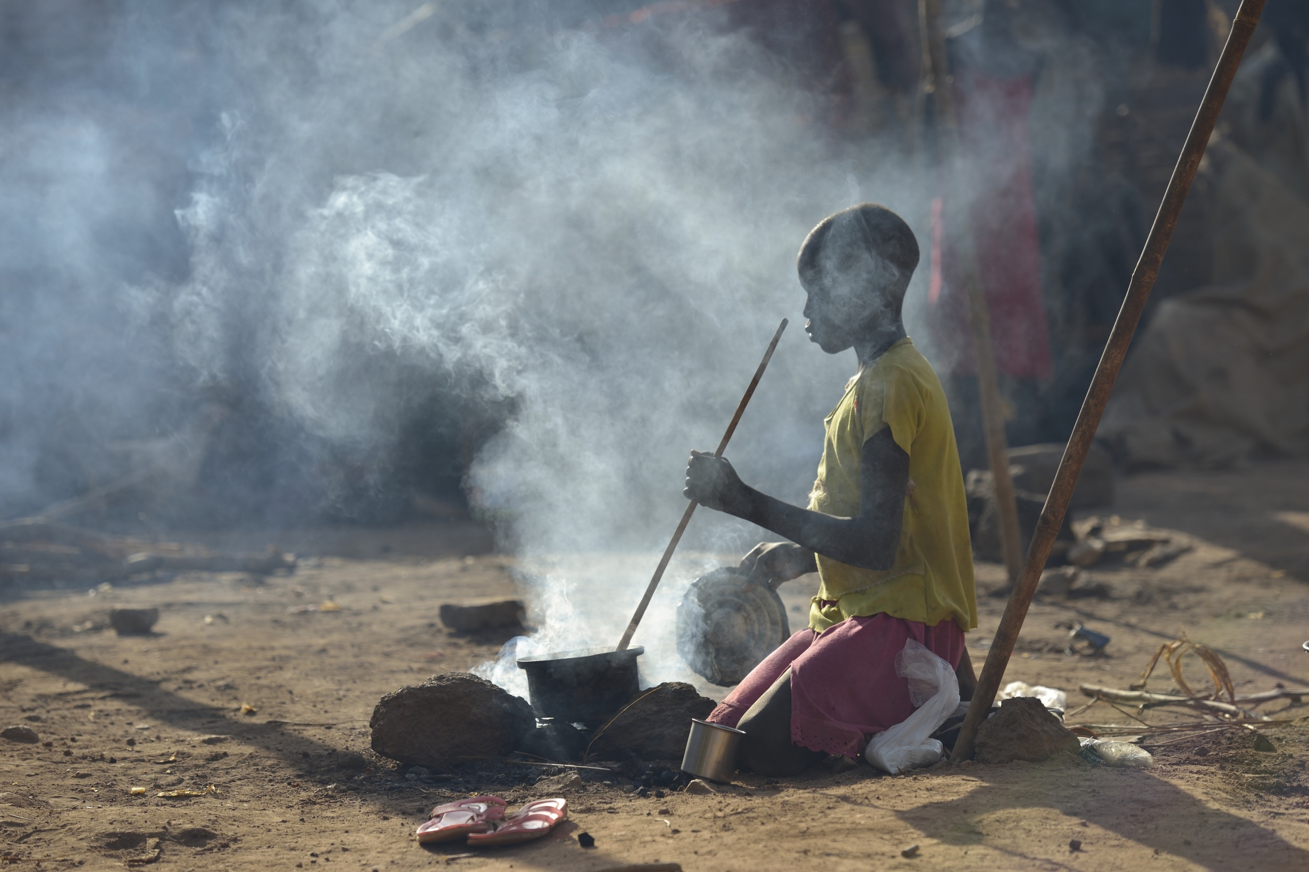
© Paul Jeffrey/ACT Alliance

Slide 28
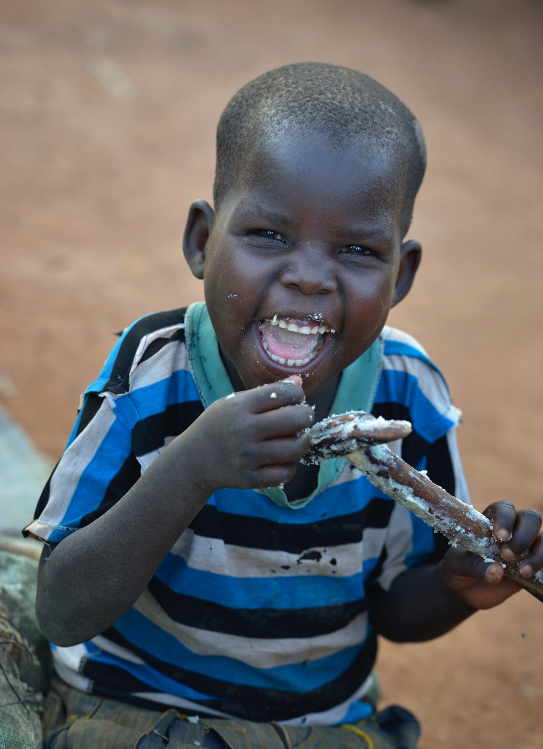
© Paul Jeffrey/ACT Alliance

Slide 29
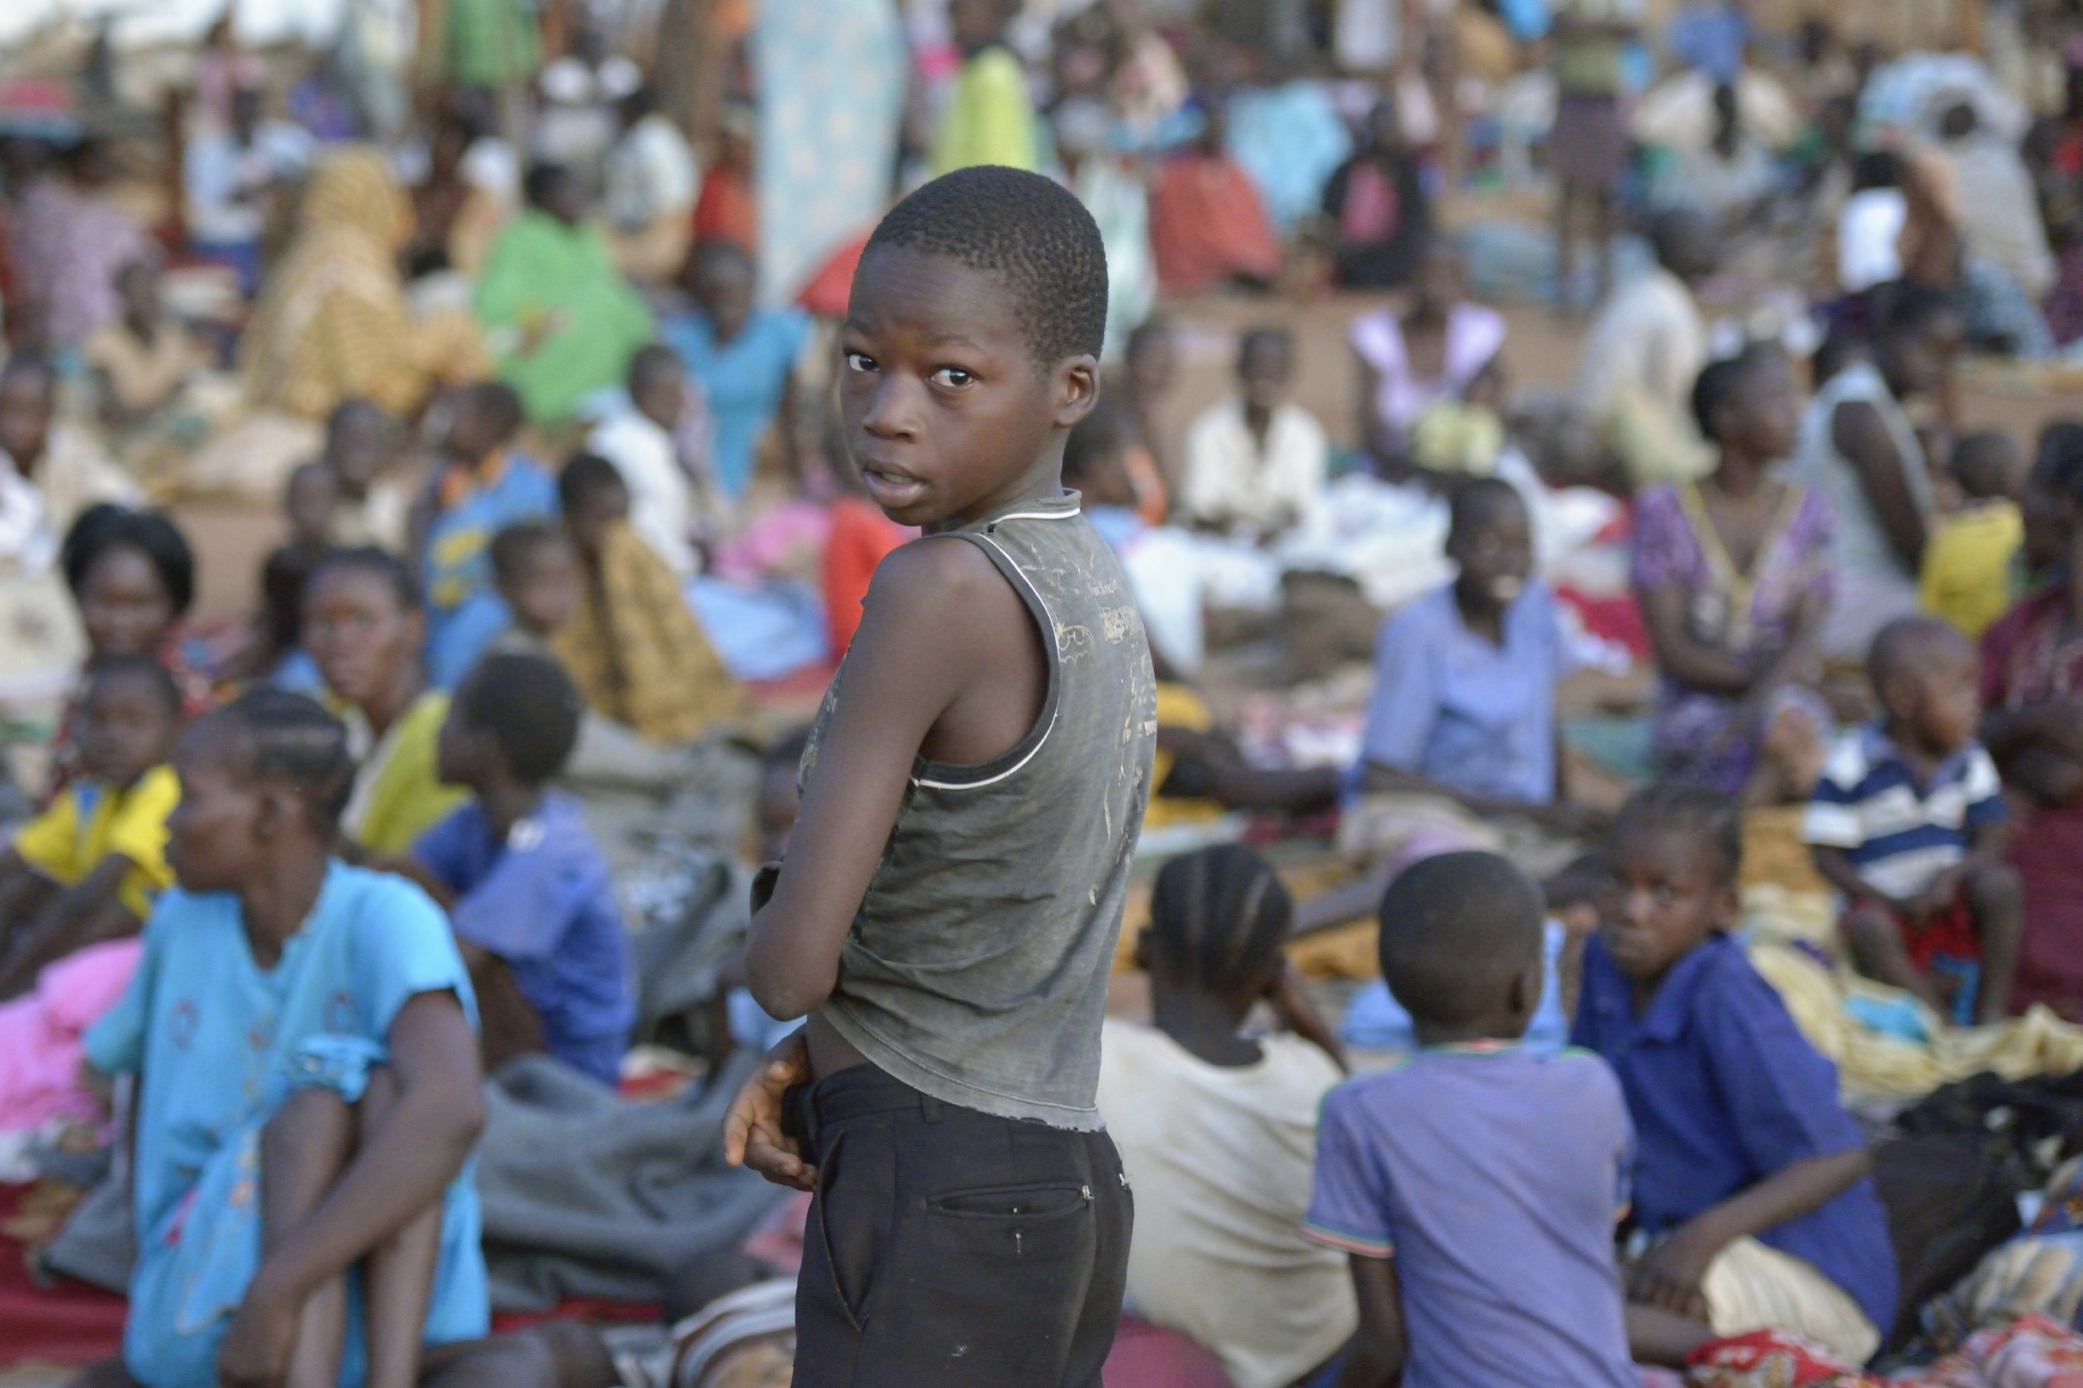
© Paul Jeffrey/ACT Alliance

Slide 30
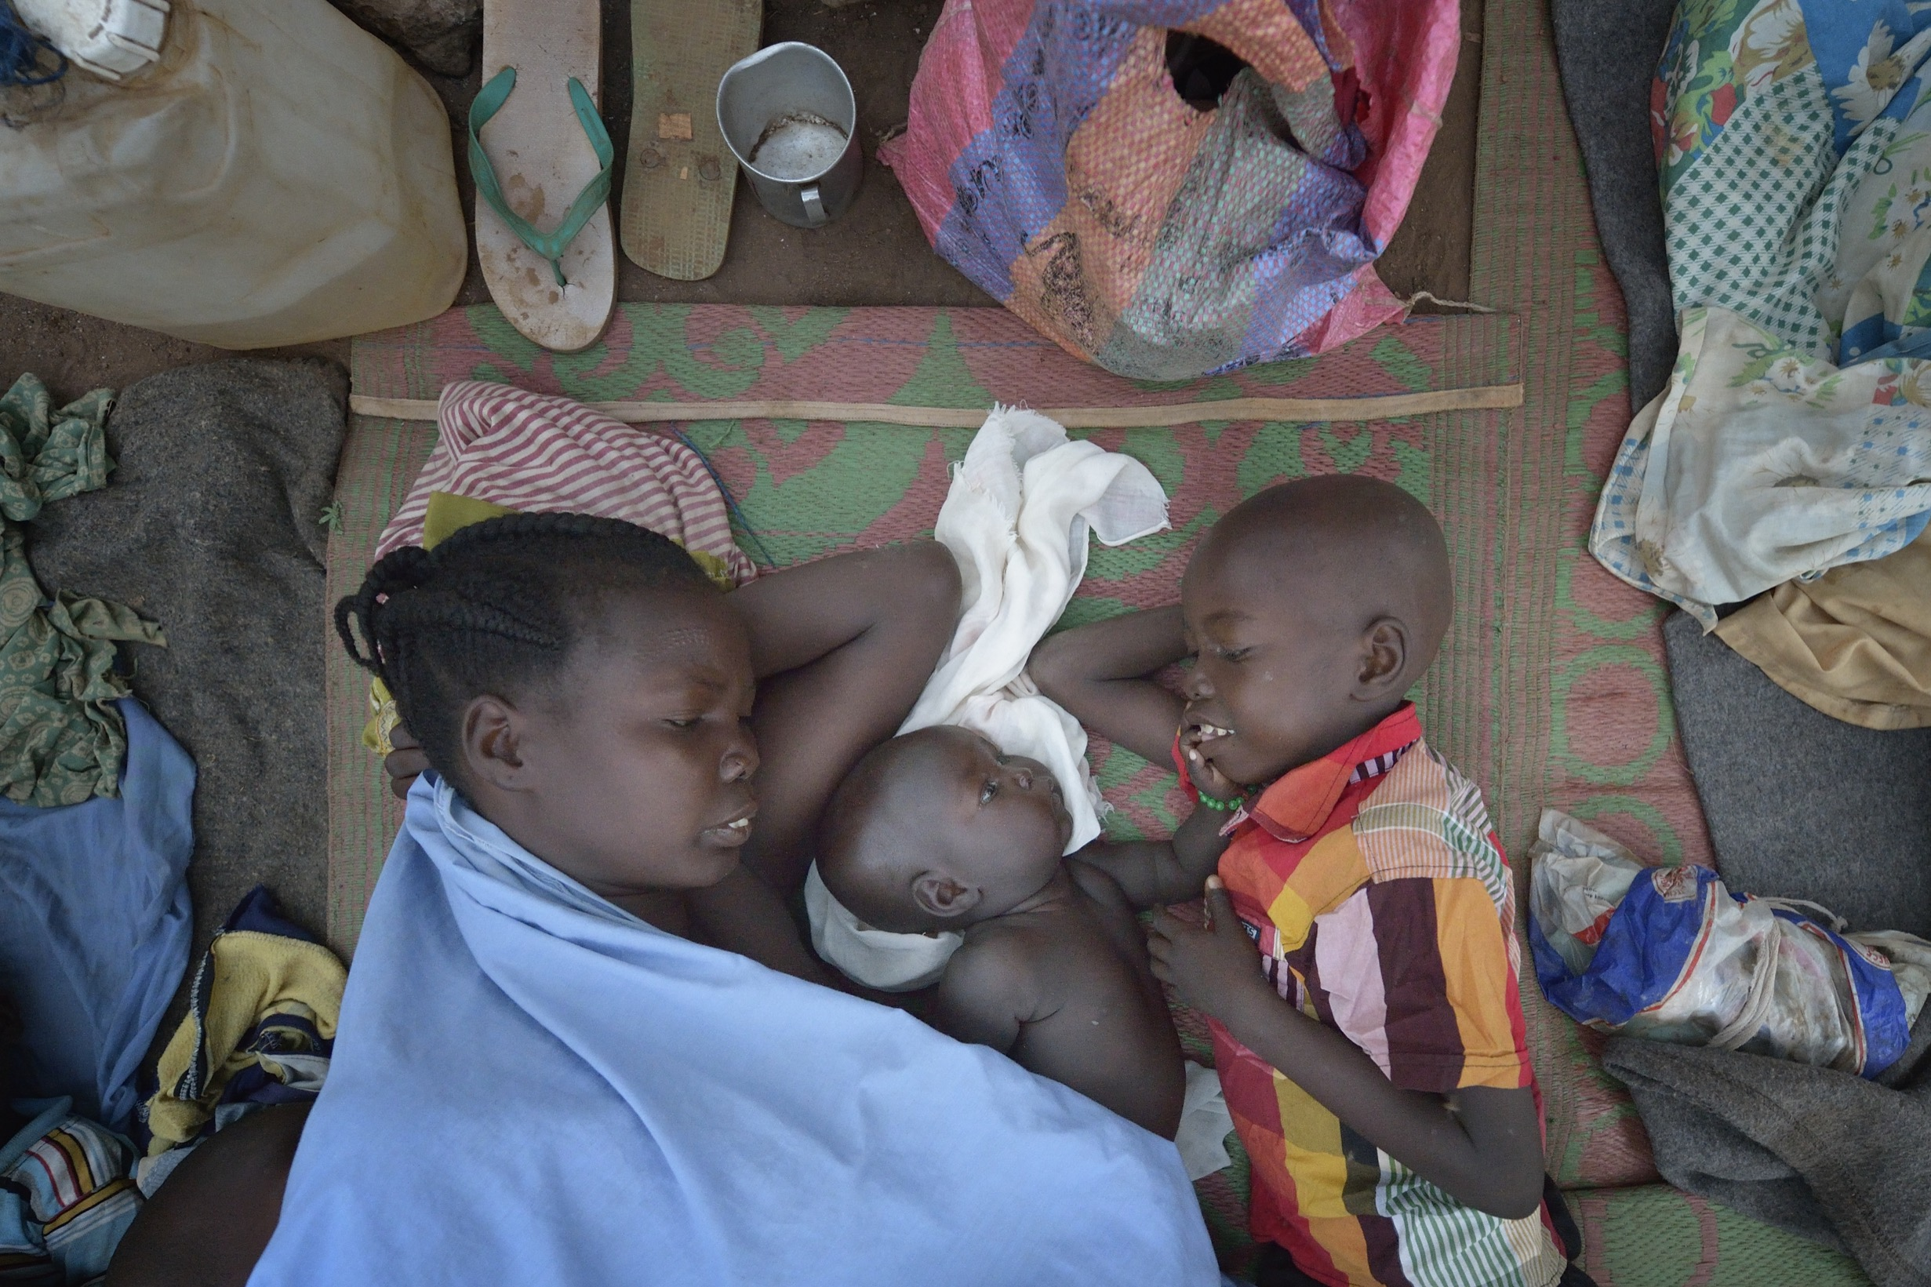
© Paul Jeffrey/ACT Alliance

Slide 31
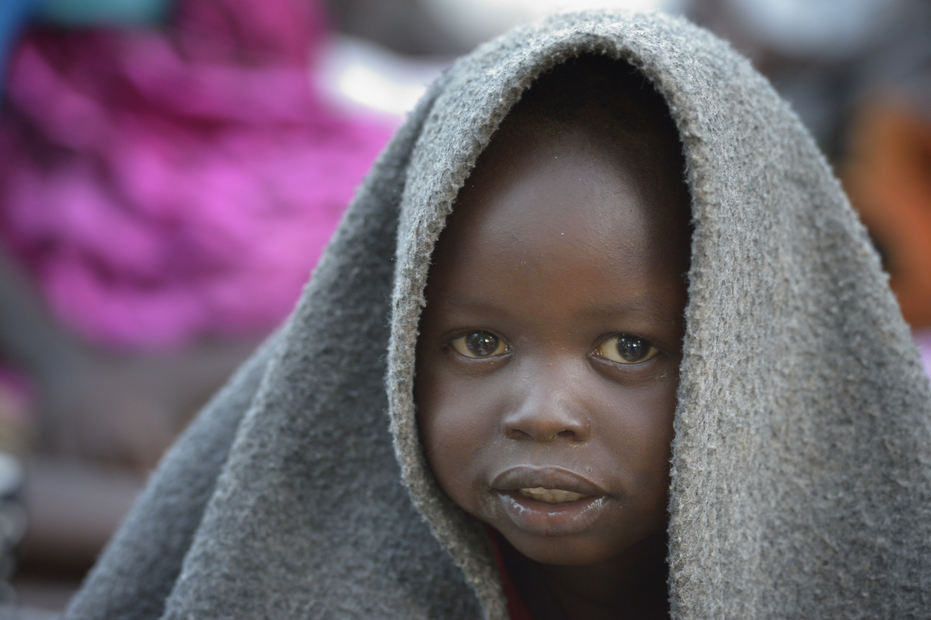
© Paul Jeffrey/ACT Alliance

Slide 32
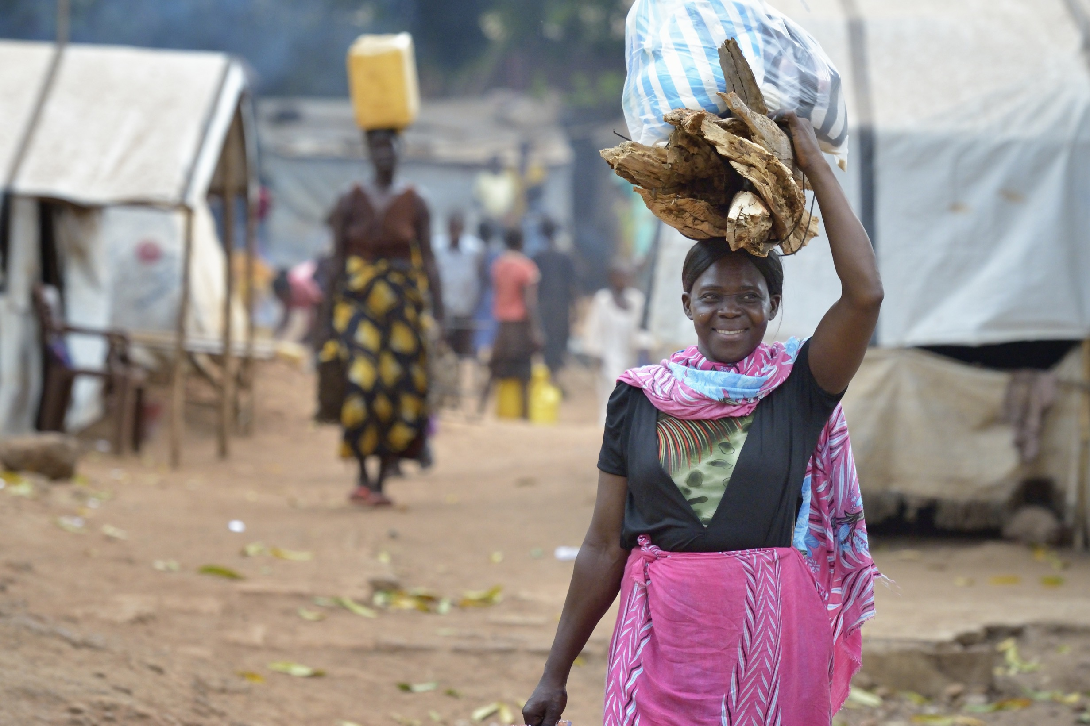
© Paul Jeffrey/ACT Alliance

Slide 33
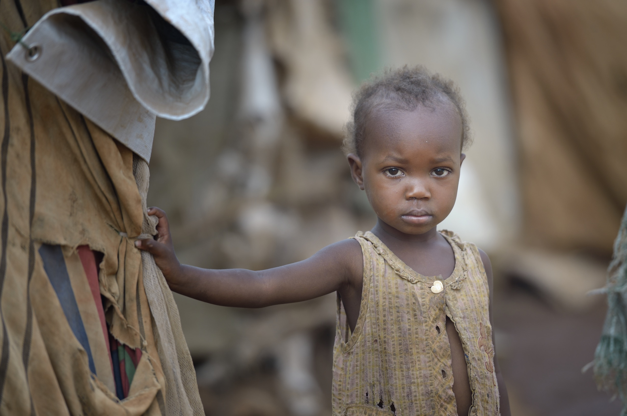
© Paul Jeffrey/ACT Alliance

Slide 34
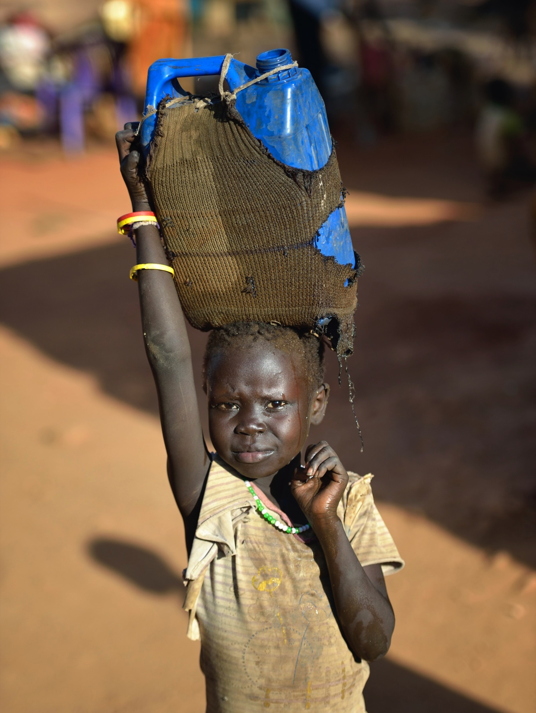
© Paul Jeffrey/ACT Alliance

Slide 35
Global Day of Prayer to End Famine – 21 May 2017
www.oikoumene.org

